Slide 1
COMPARATIVE SCENARIO EVALUATION
Ecology
Environmental Justice & Vulnerable Communities
Ecocultural Restoration & Indigenous Sovereignty
Recreation
Economy
2026 Bay Delta Science Conference

Slide 2
ECOLOGY
Using Scenario Planning and Hydrodynamic Modeling to Inform Suitability Models for Stakeholder-Selected Species of Interest in the Sacramento-San Joaquin Delta
Lynette Williams, Elsie Platzer, & John Durand
Notes:
Hi, my name is Lynette and I am representing the Ecology Subteam for Just Transitions. We used the scenario planning and hydrodynamic modeling to inform suitability models for stakeholder selected species, and we assessed landscape and food web contributions of the scenarios.

Slide 3
Criterion Definition
No perfect definition of “ecosystem health”
Just Transitions refers to “ensuring no one is left behind or bushed behind in the transitions to low-carbon and environmentally sustainable economies and societies” - what about ecology?
Delta as a novel ecosystem
Approached ecosystem function as species fundamental niches, pelagic food web production, and newly available aquatic habitat
Notes:
So there is no perfect definition for ecosystem health. The Delta is a novel system with a combination of native and non-native species. So how do we reconcile a novel ecosystem with the definition of a just transitions, which refers to ensuring that no one is left behind during a transition to a low carbon and environmentally sustainable economy and society? So we approached the ecology aspect of this project as focusing on enhancing the pre-existing novel ecosystem in ways that are beneficial to the species that live here. We focused on ecosystem function as species fundamental abiotic niches, pelagic food webs, and newly available aquatic habitat.

Slide 4
Why this criterion matters
The Delta has lost over 90% of its historic wetlands (Whipple et al. 2014).
Many species have significant cultural and ecological importance in the region, and many are facing delines
When considering a “Just Transition” we should consider a functional ecosystem as part of that transition.
Notes:
And this matters because since colonization the delta has lost over 90% of its historic wetlands. Many of the species that are currently here have significant cultural and ecological importance in the region, and many are facing declines. So when considering what a just transition we should consider a functional ecosystem as requisite.

Slide 5
How it was developed
Species of Interest - survey of June 2025 workshop participants
  Paired with known salinity and temperature tolerances (are we actually able to model it?)
  Moyle 2002; Moyle and Cech 2001; etc.
Landscape - using newly accessible acres
Food webs - used constants for relative food web contributions multiplied times new acres
Conceptual models - visuals to describe changes per scenarios
Notes:
So ultimately our criteria were developed to be 4 main deliverables for this project. First, we isolated species of interest using feedback from stakeholders. We combined this with known functional abiotic thresholds for salinity and temperature tolerances. We wanted to represent pieces that people were interested in understanding how the scenarios would impact, but we also wanted to be sure tha temperature and salinity thresholds were actually useful for the species. We will go into more detail about this in a bit. We also evaluated newly accessible aquatic habitat, and food web contributions. We are tying all of this up with conceptual modeling to describe the various changes according to scenario.

Slide 6
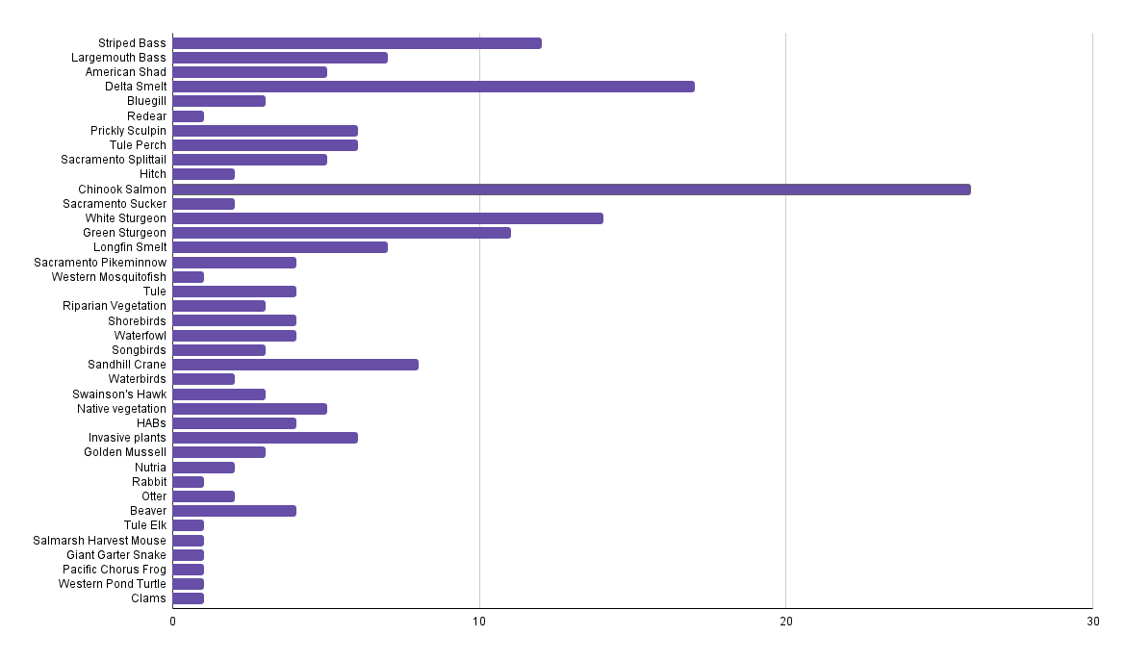
How it was developed
(the why here, based on public and expert input)
Striped Bass
Largemouth Bass
Chinook Salmon
Longfin Smelt
Invasive Plants
Clams
Notes:
At our June 2025 workshop we asked participants to fill out a questionnaire telling us what species they are interested in seeing how each scenario impacts them. We couldn’t do some of them, such as “songbirds” but we selected some top choices where salinity and temperature could be informative. Here are our species we selected according to their prevalence in our questionnaire.

Slide 7
Ecology Metrics
Metric | Definition | Measurement
Species-specific modeling | Specific species or species groups of interest from our June 2025 stakeholder workshop. Using temperature and salinity to determine functional abiotic niche. Two metrics of suitability - proportion of suitable points and average length of suitable consecutive days. | Measured as proportion of suitable days per region for a species of interest and average steak length per point of suitabilities.
Landscape and food web modeling | Landscape-level rankings will be based on newly accessible acres for aquatic biota. Food web modeling with incorporate “food web positive” landscape acreage. | Landscape is calculated as newly accessible acres and food webs are calculated as relative food web contributions multiplied by new acreage to form a food web proxy.
Conceptual models | To describe the food web changes and changes in habitat accessibility for each scenario, we will create a series of conceptual models describing ecosystem-wide interactions. | Conceptual models are the way to condense information and collate differences between scenarios
Notes:
Once we got our species of interests we split these species-specific models into two metrics - total proportion of suitable points, and average length of suitable consecutive days for all of our points. I want to be really clear that for species-specific modeling we are just looking at the fundamental abiotic niche - the physiological tolerances of those species - we are not modeling occupancy, or populations, nor are we modeling other factors that go into a species’ realized niche, like vegetation structure, or competition, or predation, or anything. This is simply an exercise to determine where meets a species’ minimum physiological needs from a water chemistry perspective. We also assessed landscape in newly accessible wetland acres, and food web modeling according to food web positive landscape acreage. We are pulling this all together with conceptual models, which we won’t touch on too much todat.

Slide 8
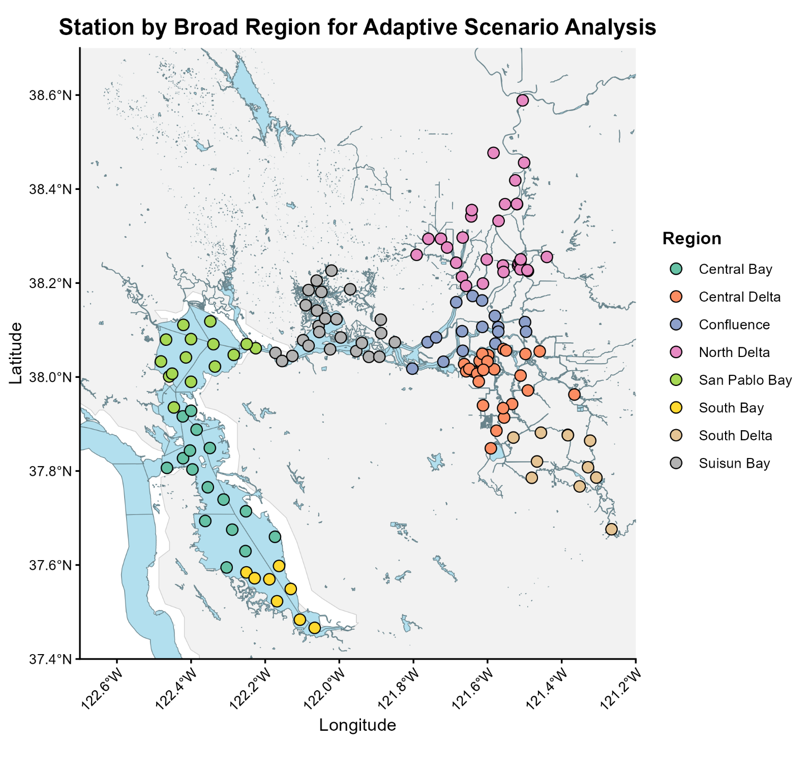
Delta Sub-regional Map
Total of 145 points across the Estuary
Adapted broad Delta regions from Pien et al. 2025 and Grimaldo et al. 2020
Regions grouped by temperature similarities, or by known regional divisions
Map here
Notes:
For our regions we selected 145 points across the estuary. We grouped our regions using pien et al. 2025, which grouped regions based on Euclidean distances of temperatures at specific stations, and using grimaldo et al. 2020, which nicely shows known diversions for the bay delta.

Slide 9
Species Suitability Thresholds
Species | Salinity | Temperature
Egeria densa | < 5 psu | > 3 C < 26 C
Largemouth Bass | < 4 psu | > 3 C < 28 C
Overbite Clam juvenile | >5 psu <25 psu | >3 C < 26 C
Juvenile Striped Bass | >0 psu < 35 psu | >12 C <27 C
Juvenile Chinook Salmon | >0 psu <35 psu | >10 C <25 C
Longfin smelt juvenile | >0.4 psu <10 psu | >9 C <15 C
Longfin smelt adult | >15 psu <30 psu | >9 C <18 C
Notes:
And here are the species thresholds we used. We used conservative numbers, especially with temperature, and tried to represent the thresholds at which species start to feel significant physiological stress. Again, we only used this for functional abiotic niches, so where can a species survive at any given point given no other stressors.

Slide 10
Species of Interest APPROACH
Method | Description
Date Filter | Spring pulse flows, and spawning - February 1 through June 1
Species Threshold Data | If individual day per site falls within the salinity AND temperature bracket = 1; if one or both don’t meet the criteria = 0
Proportion of Suitable Days | Total number of suitable days at all sites/total number of days and sites in the run
Average Streak Length | The mean of number of consecutive days per site divided by the total number of streaks
Notes:
We want to be really clear that we are not modeling occupancy, or populations. We are modeling where, according to the hydrodynamic outputs, reach the minimal thresholds for where a species can physiologically exist in space in time We are not taking into other covariates that contribute to a species realized niche - landscape, predation, competition, vegetation structure - that contribute to where a species actually is in space and time. Our points also span throughout the estuary, including regions of the bay, but most of our points are in the legal delta. We started off our modeling with isolating this spring pulse flow and spawning period, so we are only using data from february 1st to june 1st. For threshold data, if an individual day at an individual site falls within the salinity and temperature bracket, it was assigned to a 1. If one or both did not meet the criteria, we assigned it to a zero. For proportion of suitable days we took the total number of suitable days and divided by the total number of days in the run. Then we wanted to look at streak lengths - so how many average consecutive suitable days were in the run. We calculated average number of suitable consecutive days per site, then divided by the total number of streaks.

Slide 11
Overall Results Summary
Little variation between scenarios
Calling on Reserves was the most variable scenario for Species of Interest modeling
Most variation in scenarios in Suisun, San Pablo, and Confluence
 | Eco Machine | New Green Watershed | Calling on Reserves | Other
2019 Proportions | Longfin Juv | Longfin Juv | Chinook
2020 Proportions | Clams LMB, Egeria | Clams LMB, Egeria | Clams LMB, Egeria
2019 Streaks | LMB, Egeria | Egeria, Chinook, Ad. SB | Ad. Longfin, Chinook SB, Egeria, LMB | Juv. SB (BF) Ad. SB (BF)
2020 Streaks | LMB, Egeria | LMB, Egeria | Ad. Longfin, Ad. SB, Egeria LMB, Clam, CS, juvSB | Juv. SB (BF)
Notes:
So a general results of our summary showed little variation between scenarios. Calling on reserves was the most variable for the species of interest, and new green watershed and ego machine were often close to identical. Here is a quick summary where I have species that declined according to baseline in red, and species that increased from baseline in blue. Generally we saw decreases in freshwater obligates with increases in species that prefer saltier conditions, which can be expected. So where clams increased often corresponded to decrease in largemouth bass and egeria. But the increases and decreases that we are talking about are usually within 1 to 2 difference from the baseline. So very slight.

Slide 12
PERFORMANCE: ALL SPECIES SUITABILITY
Proportion of suitable points (2019 ONLY)
RANK | -5 | -4 | -3 | -2 | -1 | 0 | 1 | 2 | 3 | 4 | 5
Business As Usual |  |  |  |  |  | X
Eco Machine |  |  |  |  |  | X | X
New Green Watershed |  |  |  |  |  | X | X
Bolster & Fortify |  |  |  |  |  | X
Calling On Reserves |  |  |  |  |  | X | X
SPECIES OF INTEREST
+1%= increases by 1 from baseline
-1% = decreases by 1 from baseline
Juvenile Longfin Smelt I Adult Longfin Smelt
Juvenile Chinook Salmon I Juvenile Striped Bass
+1% = decreases by 1 from baseline
-1%= increases by 1 from baseline
Largemouth Bass
Egeria I Overbite Clam
X * All Others
Notes:
We will start with proportions. Generally with these plots the blue, green, and orange species will increase in rank with increases in suitability from baseline, and the yellow, red, and pink will increase in rank from the baseline if they decrease in suitability. This is proportion of suitable points for 2019 only. 2019 was a wet year, where we wouldn’t expect a ton of variation.. Each increase or decrease in a step corresponds to a 1% change. We don’t see a ton of variation. Each increase in the ranking here represents a 1% increase in suitable points. So pretty clustered around the baseline during a wet year, with small increases for our species that require small amounts of salt or colder conditions.
But this gives an overall assessment of performance, but we wanted to gauge of temporal element for how long certain points are suitable for certain species.

Slide 13
PERFORMANCE: ALL SPECIES SUITABILITY
Proportion of suitable points (2020 only)
RANK | -5 | -4 | -3 | -2 | -1 | 0 | 1 | 2 | 3 | 4 | 5
Business As Usual |  |  |  |  |  | X
Eco Machine |  |  |  |  | 0 | X | 0 | 0
New Green Watershed |  |  |  |  | 0 | X | 0 | 0
Bolster & Fortify |  |  |  |  |  | X
Calling On Reserves |  |  |  |  | 0 | X |  | 00
SPECIES OF INTEREST
+1%= increases by 1 from baseline
-1% = decreases by 1 from baseline
Juvenile Longfin Smelt I Adult Longfin Smelt
Juvenile Chinook Salmon I Juvenile Striped Bass
+1% = decreases by 1 from baseline
-1%= increases by 1 from baseline
Largemouth Bass
Egeria I Overbite Clam
X * All Others
Notes:
Here is the suitabilities for 2020, so dry year, for calling on reserves. Eco machine, and ngw we see proportion of suitable points decreasing for largemouth bass and egeria and increasing for overbite clam. Every other species is clustered around the baseline conditions. This makes sense to me because largemouth bass and egeria are highly salinity senstitive, their upper thresholds are 4 and and 5 respectively, so drier conditions can be expected to create less favorable conditions. Overbite clam juveniles though have a lower threshold of 5, so it makes sene that those are mirrored here.

Slide 14
PERFORMANCE: ALL SPECIES SUITABILITY
Average Streak of Consecutive Suitable Days (2019 ONLY)
RANK | -5 | -4 | -3 | -2 | -1 | 0 | 1 | 2 | 3 | 4 | 5
Business As Usual |  |  |  |  |  | X
Eco Machine |  |  |  |  |  | X | 00
New Green Watershed |  |  |  |  | XX | X | 0
Bolster & Fortify |  |  |  |  | X | X | X
Calling On Reserves |  |  | X | 0 | X0 | X |  | X |  |  | X
SPECIES OF INTEREST
+1 day = increases by 1 from baseline
-1 day = decreases by 1 from baseline
Juvenile Longfin Smelt I Adult Longfin Smelt
Juvenile Chinook Salmon I Juvenile Striped Bass
+1 day = decreases by 1 from baseline
-1 day = increases by 1 from baseline
Largemouth Bass
Egeria I Overbite Clam
X * All Others
Adult Striped Bass
Notes:
For our average streak of consecutive days we see more variation. Each increase or decrease only corresponds to a 1 day change in average streak lengths. Each additional day for any smelt, salmon, or striped bass increases by 1 from the baseline, and any additional day for our less desirable species - egeria, overbite clam, and largemouth bass corresponds to a lower number. Here you can see that in eco machine and new green watershed the streak lengths for bass and egeria decrease a bit. We see increases in streak lengths for juvenile chinook increase by 6 days in calling on reserves, which typically had cooler water temperatures, and increase for adult longfin. Calling on reserves also saw an increase in largemouth bass, and egeria streak lengths, and a decrease for juvenile striped bass. Again, calling on reserves is the odd-scenario out in terms of deviations from the baseline. So more deviation in streaks that overall proportions. So all it takes is one “unsuitable” day to break a streak and move these values around. This is more a metric of stability in water chemistry across the points.

Slide 15
PERFORMANCE: ALL SPECIES SUITABILITY
Average Streak of Consecutive Suitable Days (2020 ONLY)
RANK | 0 | 1 | 2 | 3 | 4 | 5 | 6 | 7 | 8 | 9 | 10
Business As Usual |  |  |  |  |  | X
Eco Machine |  |  |  |  |  | X | 0 | 0
New Green Watershed |  |  |  |  |  | X |  | 00
Bolster & Fortify |  |  |  |  |  | X | X
Calling On Reserves |  |  |  |  | XX0 | X | XX0 | 0
SPECIES OF INTEREST
+1 day = increases by 1 from baseline
-1 day = decreases by 1 from baseline
Juvenile Longfin Smelt I Adult Longfin Smelt
Juvenile Chinook Salmon I Juvenile Striped Bass
+1 day = decreases by 1 from baseline
-1 day = increases by 1 from baseline
Largemouth Bass
Egeria I Overbite Clam
X * All Others
Adult Striped Bass
Notes:
For 2020, a dry year, we saw decreased streak lengths for largemouth bass and egeria under the restoration scenarios, and decreased streak lengths for chinook, juvenile striped bass, largemouth bass and overbite clams in calling on reserves. We saw increases in suitability for adult longfin, adult striped, and egeria. Bolster and fortify again has small deviations but it nearly identical to the baseline.

Slide 16
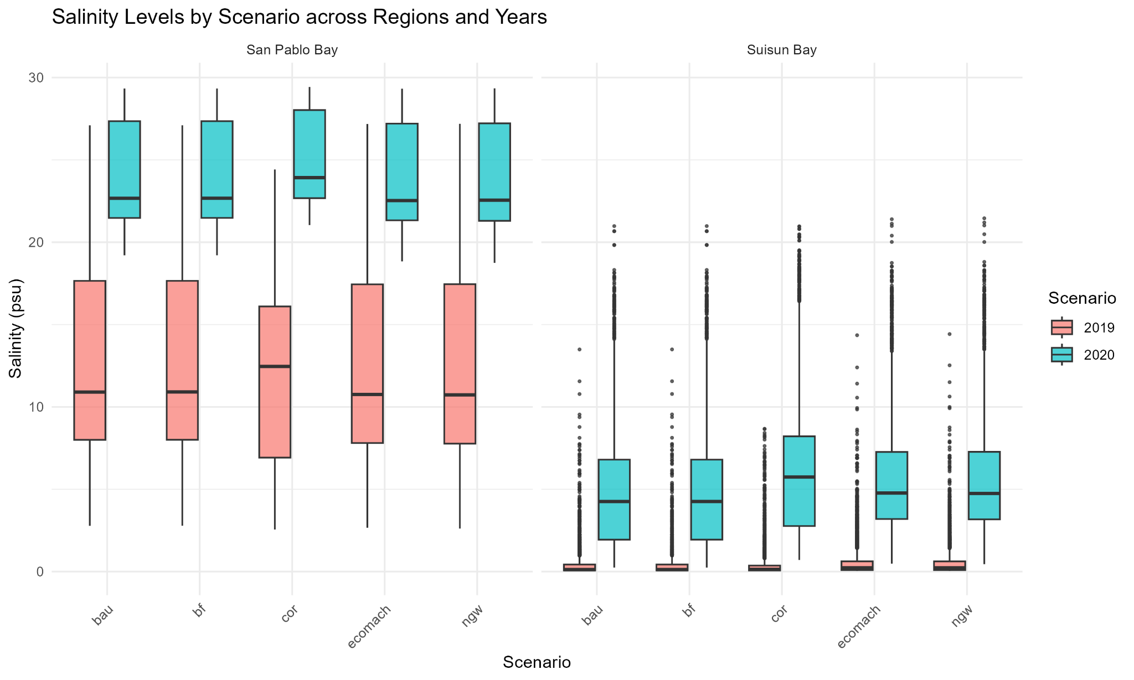
Raw Data:
Salinity
February through June
Seasonal variation
Calling on Reserves averages saltier in the San Pablo Bay in 2019, and in San Pablo and Suisun in 2020
Notes:
For salinity, here are the raw data per scenario from that february to june period., here i just isolated san pablo bay on the left and suisun bay on the right. The scenarios are at the bottom here and the scale is 0 to 30 psu. We typically saw higher salinities in 2019 and 2020 in calling on reserves, with the red boxes, as compared to the other scenarios. Otherwise we saw dramatic annual differences but no major scenario differences. So this is one of the reasons we think calling on reserves showed more variation.

Slide 17
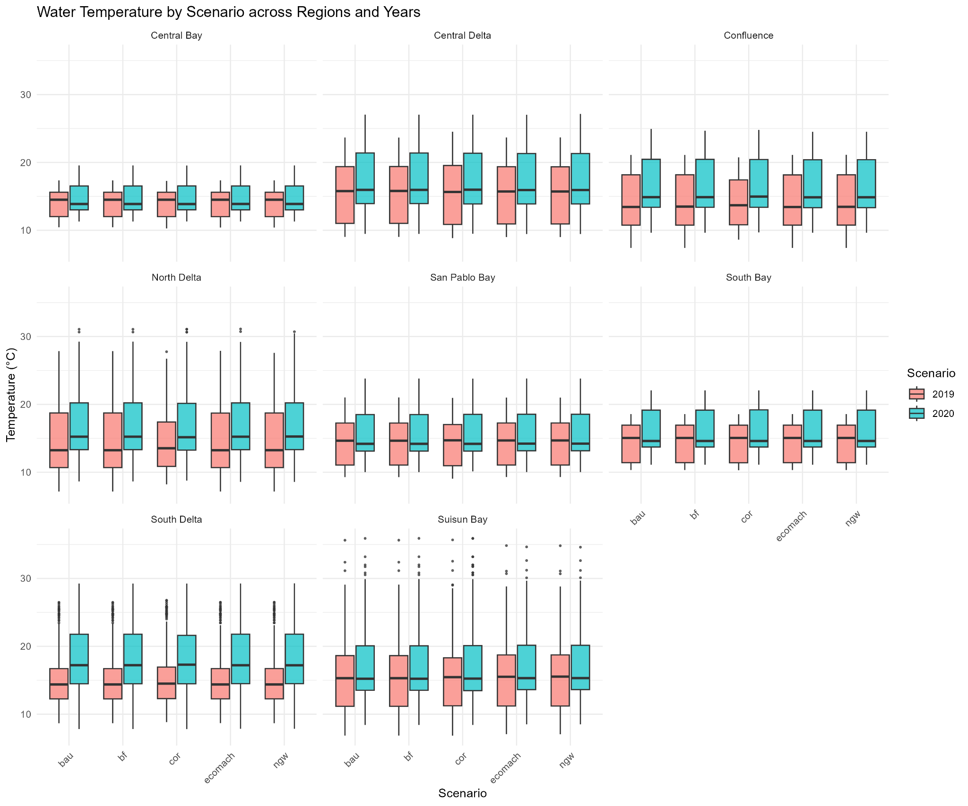
Raw Data:
Temperature
Feb through June
Seasonal variation
Median temperatures similar across years, generally higher spread in 2020 (dry year)
Notes:
Temperature is much tighter than salinity across scenarios. Really the only somewhat noticeable difference we see between scenarios is calling on reserves in san pablo bay has a lower median in 2020 than in other scenarios. Otherwise interannual variations change the medians across years but not tremendously. So we see slight differences in temperature dependent species in some areas but nothing dramatic.

Slide 18
PERFORMANCE: LANDSCAPE
Additional accessible wetland acres
RANK | -5 | -4 | -3 | -2 | -1 | 0 | 1 | 2 | 3 | 4 | 5
Business As Usual |  |  |  |  |  | X
Eco Machine |  |  |  |  |  |  |  |  | X
New Green Watershed |  |  |  |  |  |  |  |  |  |  | X
Bolster & Fortify |  |  |  |  |  | X
Calling On Reserves |  |  |  |  |  | X
A Tunnel |  |  |  |  |  | X
Notes:
For our landscape metric we took a pretty simple approach - NWG has approximately 80,000 new wetland acres. Eco Machine has about 53,000 newly accessible acres. For this metric we wanted to just compare the newly accessible aquatic acres for species to use at habitat. We anchored the baseline at 0, like for the other scenario rankings, which is anchored at 0 additional accessible wetland acres under the scenarios. New Green watershed is anchored at 5 with 80,000. So for each 16,000 acre increase it moves up a ranking. We rounded to the nearest whole number here, but the rankings increase with 16,000 acre increments.

Slide 19
Results & Scenario Ranking
Food webs -
Only evaluating Eco-Machine and NGW (landscape changes)
Adaptation Scenarios:
Eco Machine - strategic restoration
New Green Watershed
  NGW1 - 100% restoration
  NGW2 - 50% restoration, 50% wet soil agriculture
  NGW3 - 25% restoration, 75% wet soil agriculture
Assigned relative contributions to land cover - 0.2 for managed wetlands, 0.4 tidal wetlands, 0.1 wet soil ag
Total baseline managed wetland acres-5100*(0.2) + additional tidal wetland acres*(0.4)+ total wet soil ag acres-17,178*(0.1) = Proxy for food web production
Notes:
So for our last metric we will talk about today we are going to discuss food webs and how we calculated proxies for food web contributions. We only evaluated eco-machine and the three new green watershed landscape change scenarios for this one because we are only interested in the scenarios with significant land conversions. To remind everyone, we have a new green watershed scenario with 100% restoration, 50% restoration, and 25% restoration. We created an equation and assigned relative contributions to the food web per landscape type. We have wet soil ag at a 0.1, so greater contributions than zero but generally minimal food web contributions that are constrained in time, 0.2 for managed wetlands. This was was a little tricky because managed wetlands can provide pulses in food web activity during specific periods of time but it is highly variable on management, draining schedules, and what kind of managed wetland it is, but the literature indicates that they are about twice as productive for food webs as wet soil ag. Finally we assigned a 0.4 to tidal wetlands because even though food is not produced at very high rates, it is not temporally or management constrained and is available at all times of the year. So we estimated this to be twice the landscape value of managed systems. We then plugged these into a total additional acreage equation (we subtracted the pre-existing acreages of each, and that value was our food web proxy.

Slide 20
PERFORMANCE: FOOD WEBS
RANK | -5 | -4 | -3 | -2 | -1 | 0 | 1 | 2 | 3 | 4 | 5
Business As Usual |  |  |  |  |  | X
Eco Machine |  |  |  |  |  |  | X
New Green Watershed #1 |  |  |  |  |  |  |  |  |  |  | x
New Green Watershed #2 |  |  |  |  |  |  |  |  |  | x
New Green Watershed #3 |  |  |  |  |  |  |  |  |  | x
* Managed wetland acres (x) + tidal wetland acres (y) + wet soil ag acres (z)
Where x, y, z, and q are constants that represent relative contributions of each landscape type
Notes:
And here are the results using our proxy equation. Eco-machine, which has no additional landscape change apart from strategic restorations for salinity management ranked one above the baseline. The 100% restoration scenarios was anchored at 5 here, and the 25% and 50% restoration scenarios both ranked at 4’s. To calculate these we anchored 5 at the maximum value of the proxy, and then divided that value by 5, with each number corresponding to an increment in our proxy value. What you can take away here is that restoration is good, but you can achieve a high ranking for this system using managed systems and wet soil agriculture as well for pelagic food web contributions.
That is all I have for now, we are working to tie up these results in a conceptual framework for our final workshop and report to help distill to stakeholders how landscape level changes might impact the ecology of bay delta. Thank you.

Slide 21
ENVIRONMENTAL JUSTICE & VULNERABLE COMMUNITIES
Comparing Delta Adaptation Scenarios through Environmental Justice, Ecocultural Restoration and Tribal Sovereignty Criteria
Ashley N. DePew & Brett Milligan

Slide 22
Criterion Definition
Environmental Justice (EJ): "The fair treatment and meaningful involvement of all people, regardless of race, culture, national origin, or income, in the development, adoption, implementation, and enforcement of environmental laws, regulations, and policies."¹
Focus on in-Delta Communities
Vulnerability: "The intersection of exposure to climate hazards, sensitivity to those hazards, and adaptive capacity, or the ability to recover from and adapt to climate hazards."²
¹ Delta Stewardship Council. (n.d.)
² Delta Stewardship Council. (2021, p.xi)

Slide 23
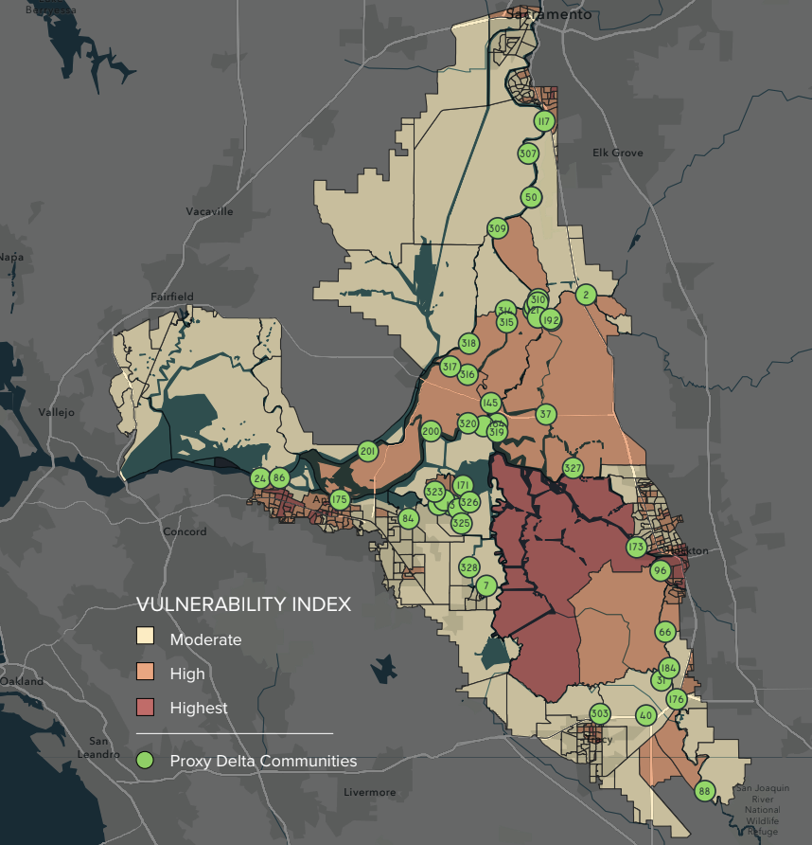
Delta Sub-regional Map
Delta Stewardship Council (2020) Vulnerability Index
14 socioeconomic indicators yield classifications:
Moderate
Vulnerability
High
Vulnerability
Highest
Vulnerability

Slide 24
Why this criterion matters
Understanding where and how negative impacts may manifest can inform decision-makers to intervene or choose alternative strategies to avoid these burdens coming to fruition.
Redress Past Inequalities
Historic underrepresentation and exclusion in Delta planning
Explore & Assess
Specific concerns & interests identified by in-Delta communities
Minimize Undue Burdens
Disproportionate negative impacts incurred by different groups of people

Slide 25
How the criterion was developed
Extensive public engagement over the course of several years:
Interviews
EJ community members & advocates
2 Public Workshops
2024, 2025
1 EJ Workshop
Vulnerability
EJ Workshop Findings Report
Advisory Committee
Periodic check-in & review
Follow-up Expert Consultations

Slide 26
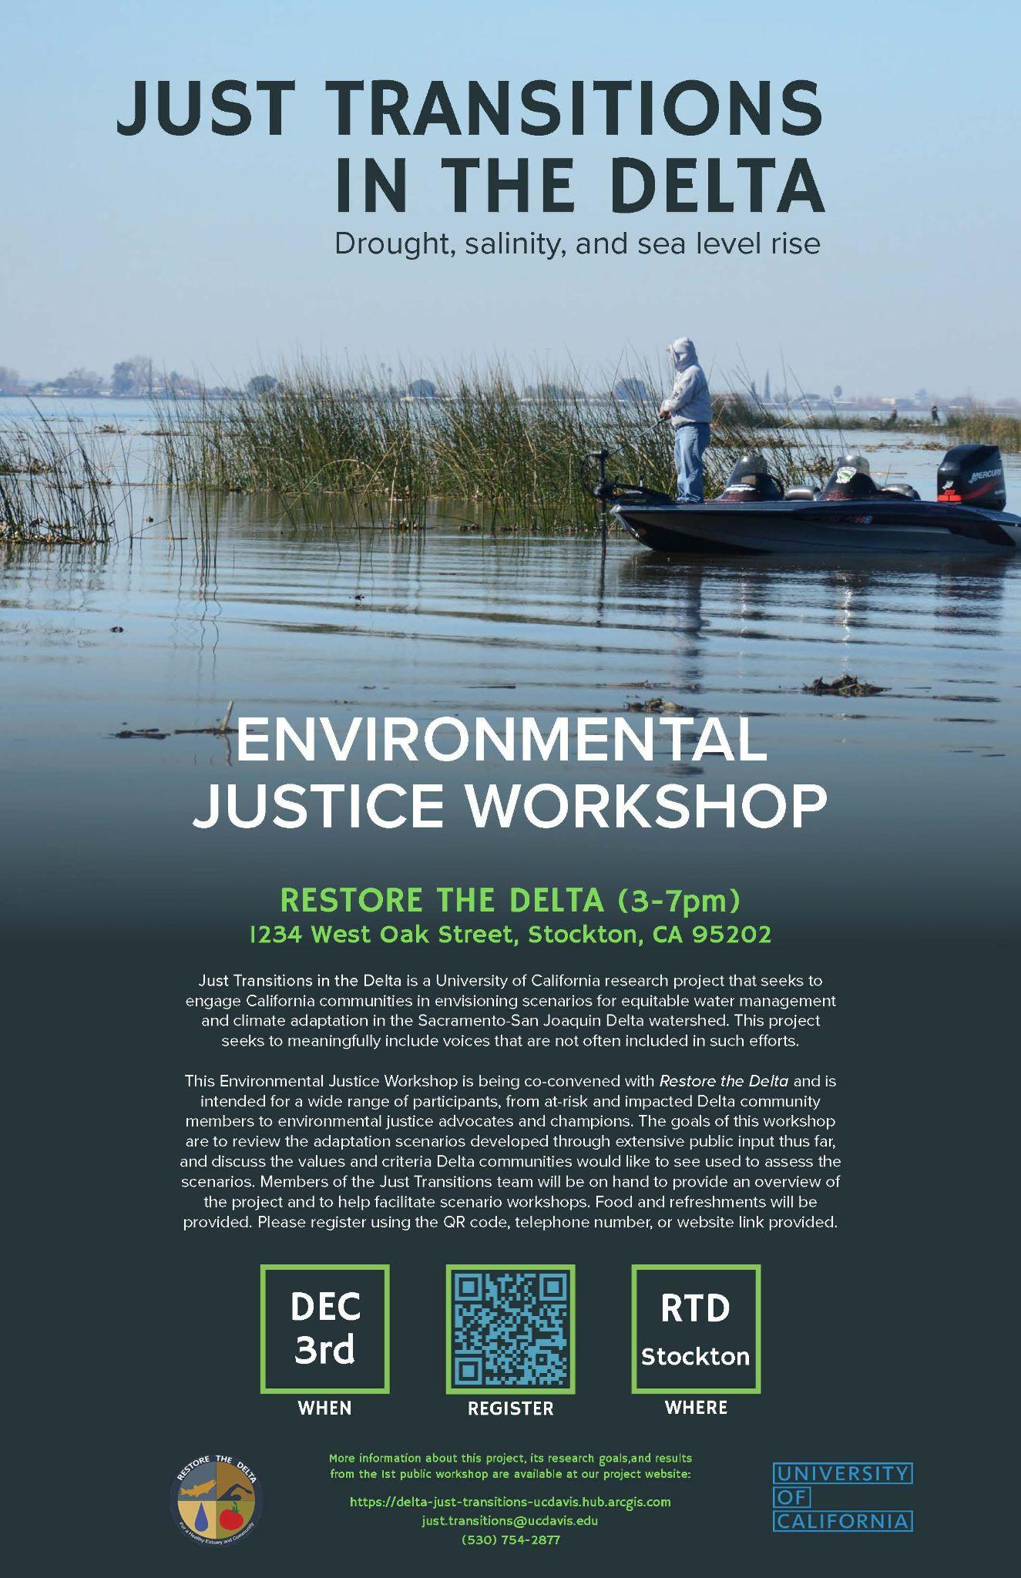
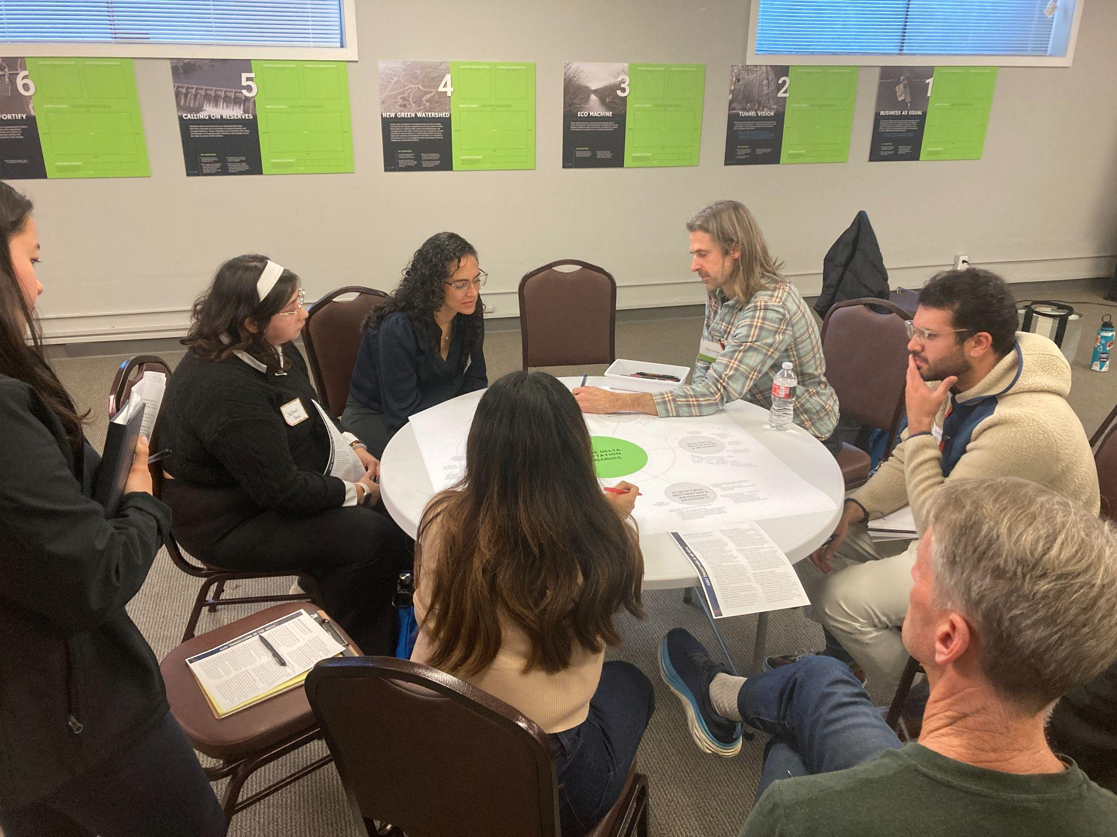

Slide 27
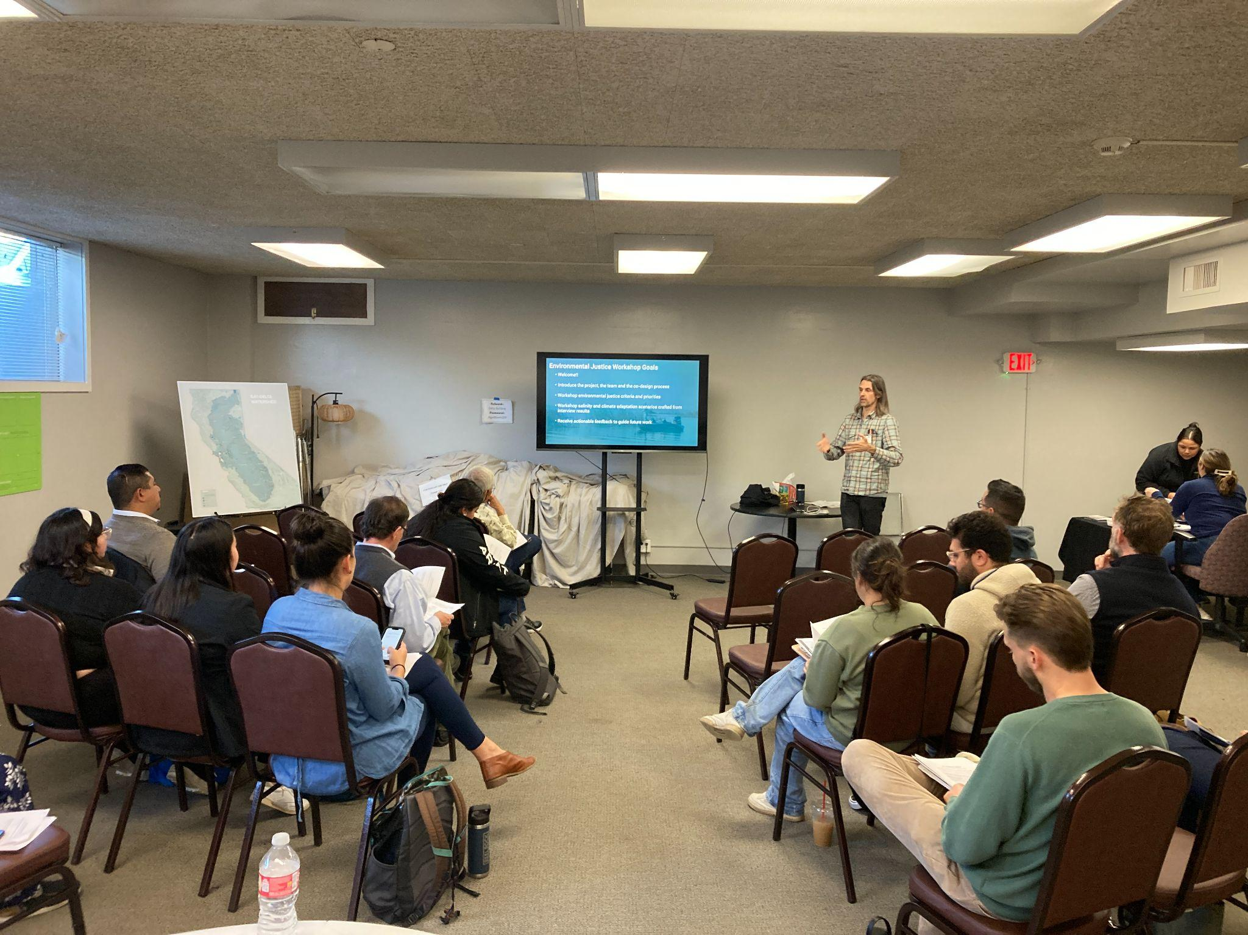
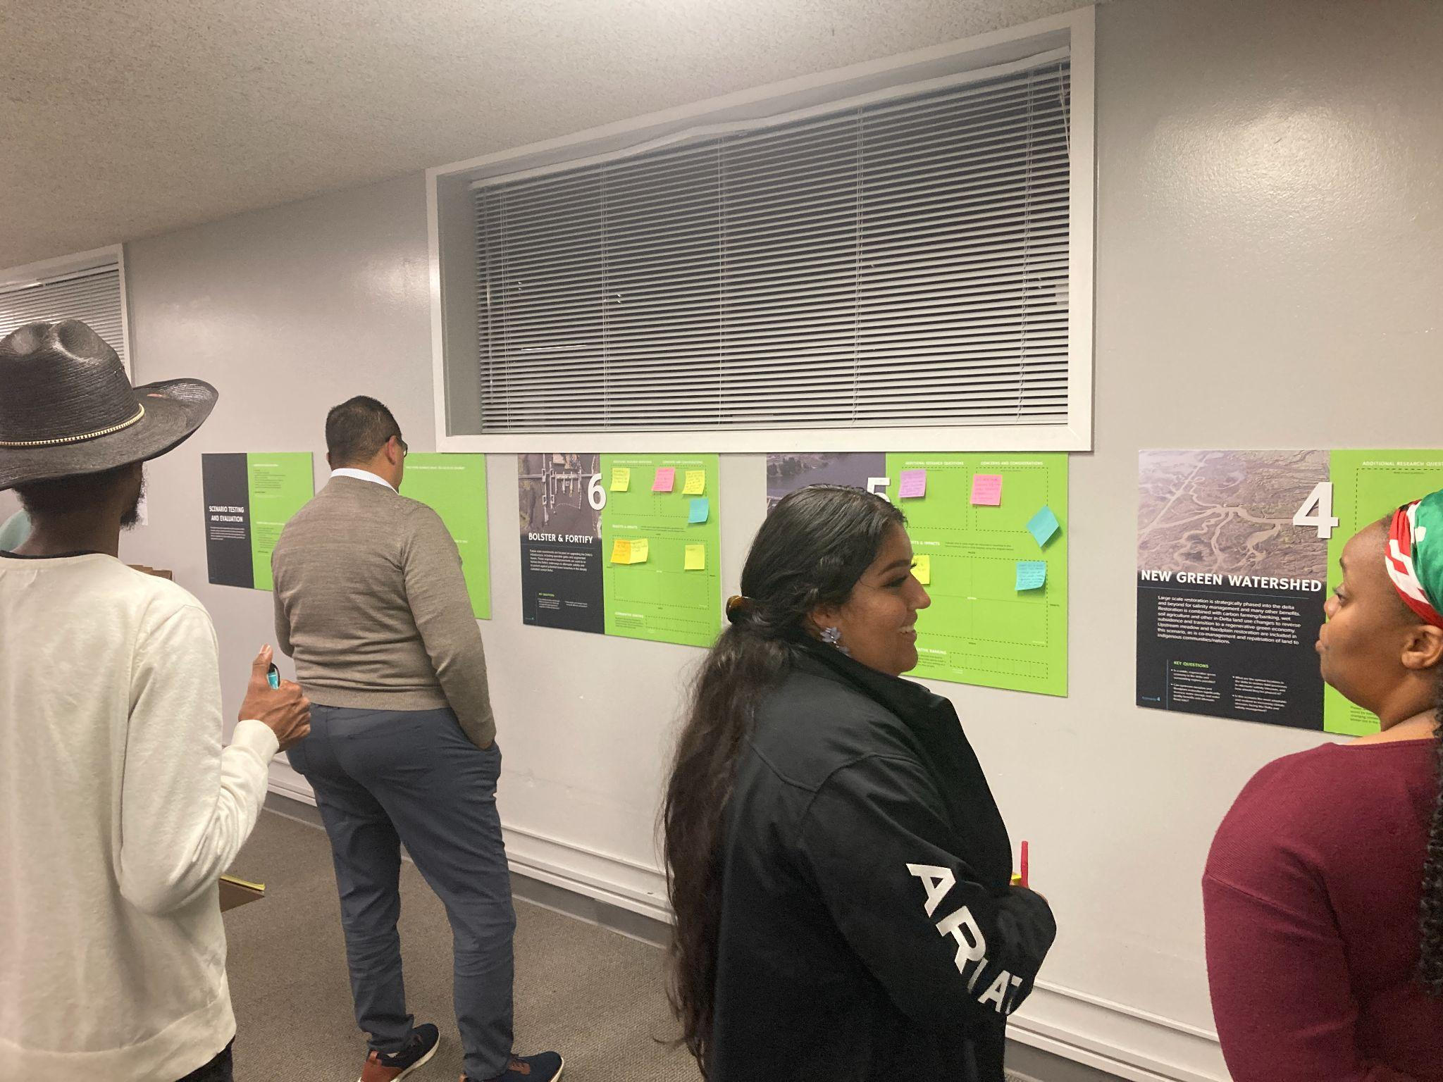

Slide 28
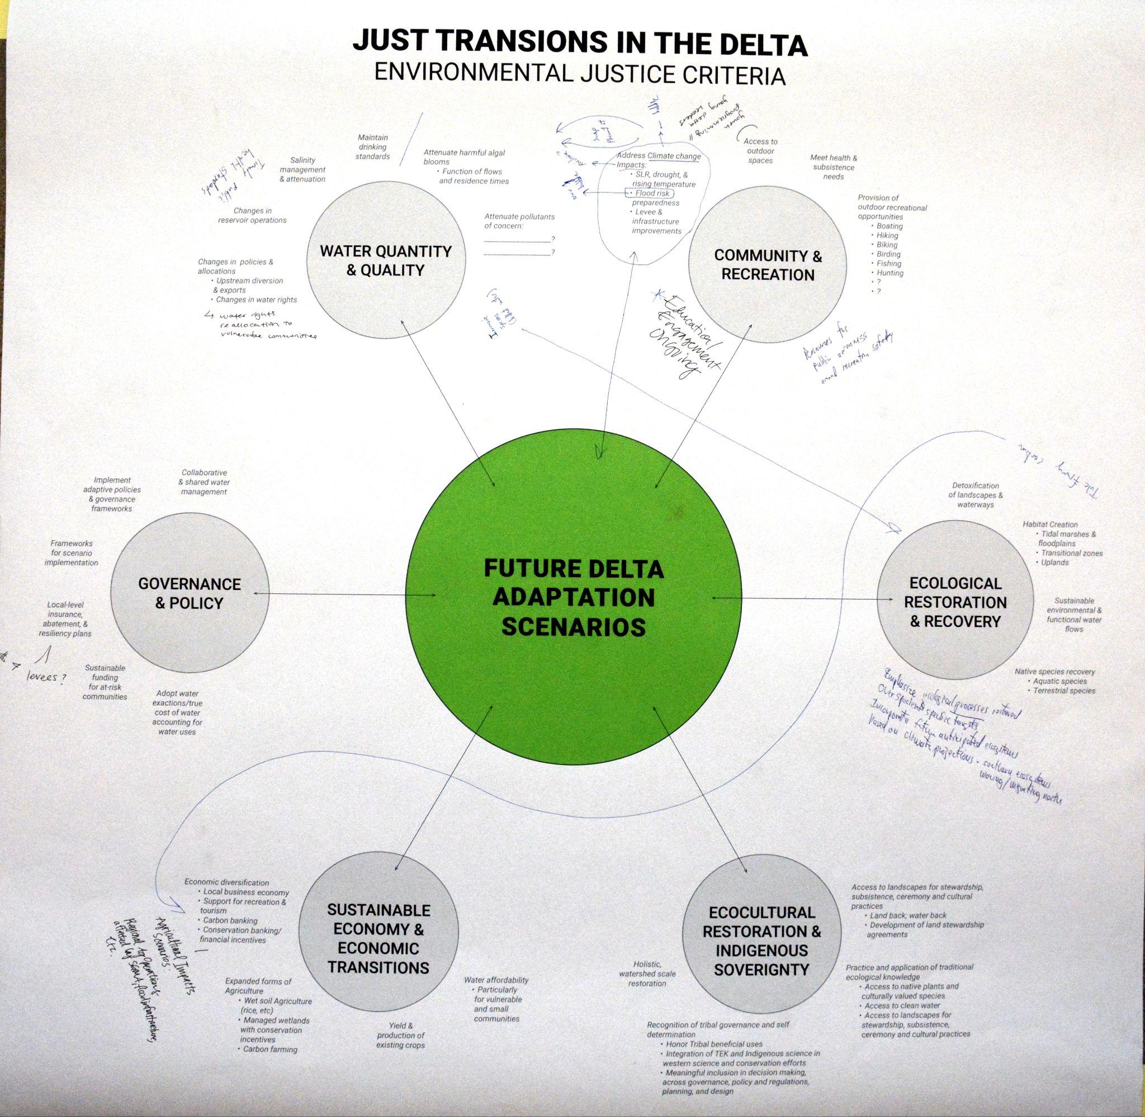
EJ Metrics
Ecocultural Restoration & Indigenous Sovereignty
Water Quality & Quantity
Community & Recreation
Flood Risk
Sustainable Economy & Economic Transitions
Ecological Restoration & Recovery
Notes:
we documented all concerns, but couldn’t address or measure all of them Or ones that are covered under other criteria (like rec).

Slide 29
EJ Metrics
Metric | Definition | Measurement
Salinity Impacts to in-Delta Drinking Water | Assessment of salinity changes on in-Delta drinking water systems' ability to meet safe drinking water standards, with special attention to impact to communities of variable vulnerability (classified in accordance with the Delta Vulnerability Index). | Percentage of run exceeding the salinity drinking water threshold of 1,050 microsiemens per centimeter (𝝁/cm)
Flood Risk Attenuation | Identification of inundation likelihood across the Delta. | Qualitative assessment of in-Delta inundation risk, given green and gray infrastructure solutions included in the scenario narratives
Water Age + Temperature | Proxy for conditions favorable for harmful algal bloom (HABs) formation | Change in water age during timeframes with water temperature above 19°C

Slide 30
Results & Scenario Ranking:
Salinity Impacts to in-Delta Drinking Water

Slide 31
Overall Drinking Water Results Summary
Increased outflows significantly improve water quality (more than most of the adaptation scenarios).
Combining physical adaptations with increased outflows would likely produce the best results.
Exceedance percentages in the highest vulnerability zone were alway 0%, across all scenarios.
Pairs of scenario performance:
  Bolster and Fortify & Business As Usual
  Eco Machine & New Green Watershed
More observed variation in tiered outflow scenarios than adaptation scenarios.

Slide 32
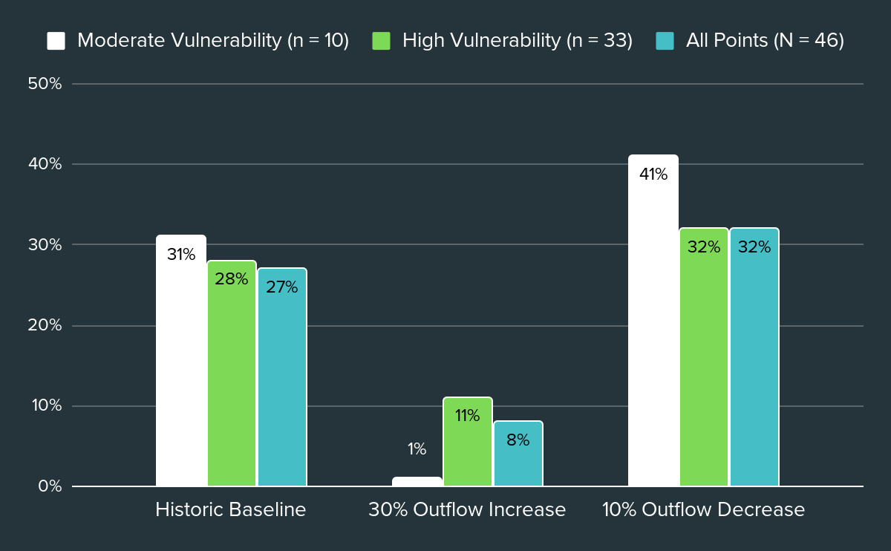
Tiered Outflow Scenario Results
Total run: October 1, 2020 - January 1, 2022
Notes:
We molded this for an extremely dry period, both drought years, 2021 particularly dry, looked at this under a time of stress
You are seeing the average for the full time period
This first
Then divided 2020 vs 2021 (both dry, 2021 drier)
Then aggregate the two years for the dry season, two years for the wet season (slide 15/16)
For slide 16 - take wet/dry out of the x axis, instead make subheadings (text box) wet (left) dry (right)
This overall slide is the main focus
Reorder for historic baseline first, then 30% outflow increase, then 10% decrease
Make x axis titles larger
Decrease space headers are taking up
Increase outflows → significant change in WQ
Don't need to show seasonality
Show vs years
Look into where exceedances are happening geographically
MOVE HISTORIC BASELINE LEFT, OUTFLOW DECREASE RIGHT

Slide 33
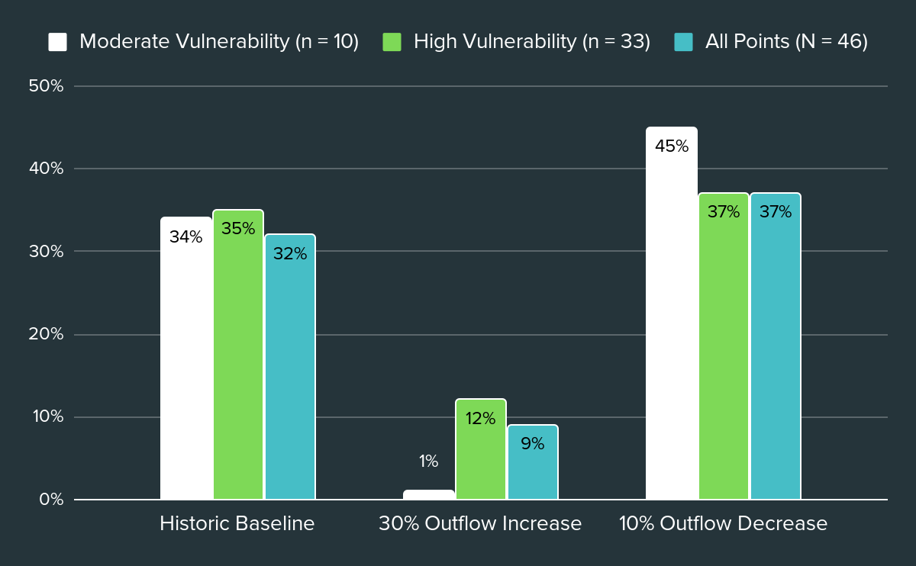
Tiered Outflow Scenario Results
Typical Dry Period: June 1, 2021 - October 31, 2021
Notes:
Takeaways - increased flows through the Delta makes a big difference
Results achieved only by reducing exports (reducing upstream diversions or combination might have different results and fresher south Delta
First - whole one (slide 13)
Then, Wet or dry year
Say 2020 and 2021, both dry
2020 vs 2021 instead of wet / dry
ADD BELOW - LEVEL OF VULNERABILITY - X AXIS LABEL

Slide 34
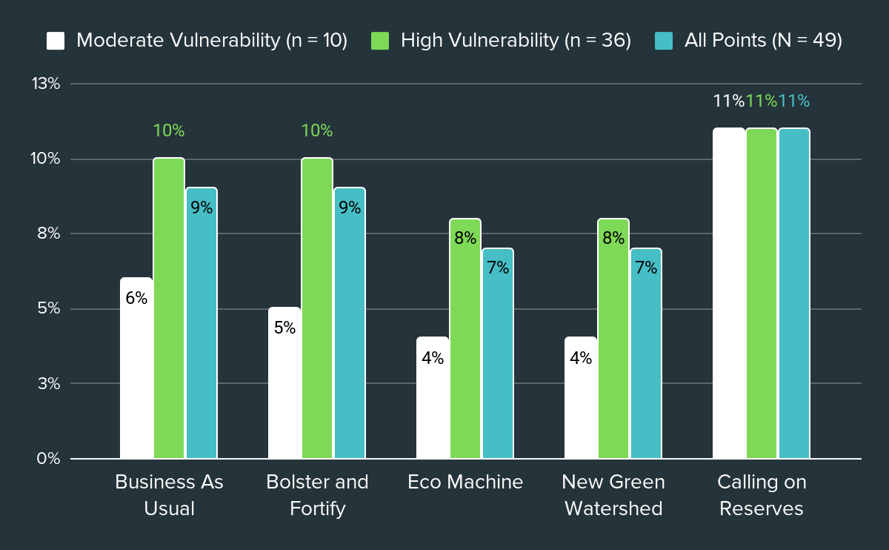
Adaptation Scenario Results
Total Run: October 1, 2018 - December 1, 2020

Slide 35
Results & Scenario Ranking:
Water Age + Temperature
(HABs Proxy)

Slide 36
Water Age + Temperature
Water Temperature ≥ 19 °C → May - October
Water Age ≥ 14 days
Assessing scenario performance based on change in water age from baseline
5 hotspot regions
Suisun Marsh & Surrounding Wetlands
McCormack- Williamson Tract
Lindsey - Cache Slough
Franks Tract
South Delta

Slide 37
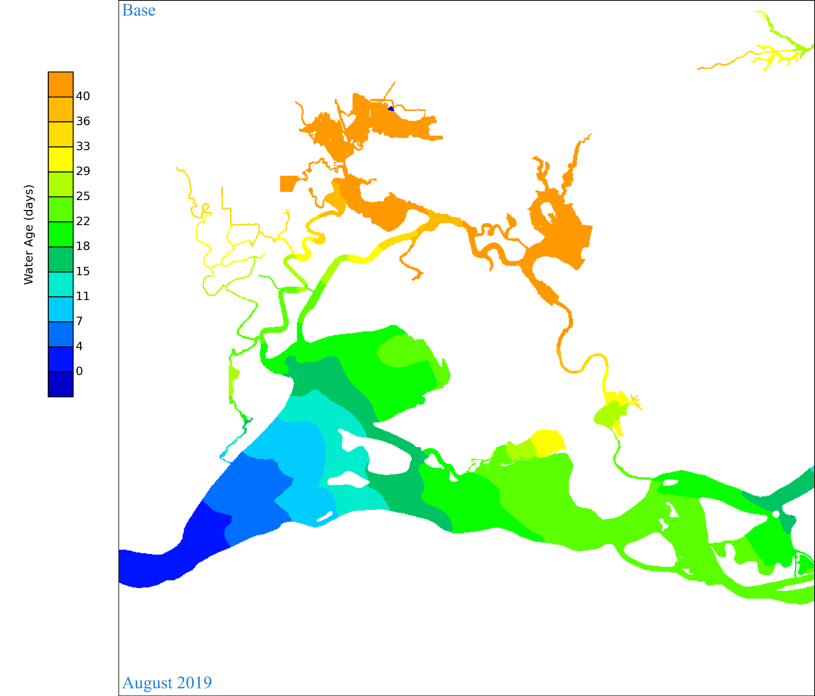
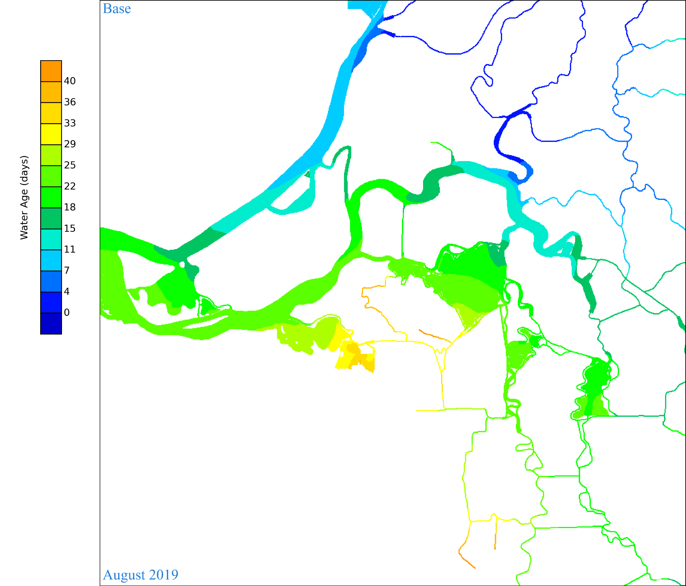
Results & Scenario Ranking (Draft)
Notes:
Heat maps of base show where the water age is already above 14 days, and where it may be below. All assessments are made as comparative change from baseline.

Slide 38
Overall Water Age + Temperature Results Summary
Results Takeaways
All regions have a water age above 14 days for the 13 months with water temperature consistently over 19 °C
October 2018, May - October 2019, May - October 2020
Decrease or No Change is only seen in Bolster and Fortify
South Delta, Lindsey - Cache slough, McCormack-Williamson Tract
Highest average increase in water age days observed in Suisun Marsh & surrounding wetlands
Scenarios occurrences: Eco Machine and New Green Watershed

Slide 39
Change in Average Days from Business As Usual
Region | Bolster and Fortify | Eco Machine | New Green Watershed
Suisun Marsh & Surrounding Wetlands | +0.1 | +7.9 | +8.0
Franks Tract | +2.2 | +5.2 | +5.3
South Delta | -0.5 | +0.3 | +0.4
Lindsey - Cache Slough | 0 | +0.4 | +3.9
McCormack-Williamson Tract | 0 | +0.5 | +0.6

Slide 40
Average Water Age Days
Region | Business As Usual | Bolster and Fortify | Eco Machine | New Green Watershed
Suisun Marsh & Surrounding Wetlands | 21.9 | 22 | 29.7 | 29.9
Franks Tract | 28.5 | 30.6 | 33.7 | 33.7
South Delta | 23.5 | 22.9 | 23.7 | 23.8
Lindsey - Cache Slough | 22.1 | 22.1 | 22.5 | 26
McCormack-Williamson Tract | 17.5 | 17.5 | 18 | 18.1

Slide 41
Scenario Ranking: Water Age
Scenario | -5 | -4 | -3 | -2 | -1 | 0 | +1 | +2 | +3 | +4 | +5
Business As Usual |  |  |  |  |  | ●
Bolster and Fortify |  |  |  |  | ●
Eco Machine |  |  |  | ●
New Green Watershed |  |  | ●
Calling on Reserves (Pending)
A Tunnel (Pending)
A Tunnel & Calling on Reserves: results pending.

Slide 42
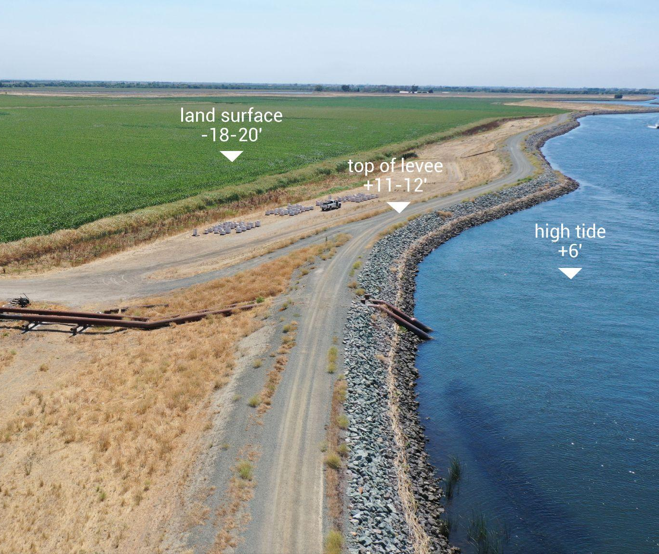
Results & Scenario Ranking:
Flood Risk

Slide 43
Flood Risk: Results & Ranking
No Change: 0
Eco Machine
Calling on Reserves
Slight
Decrease: 1
A Tunnel
Moderate
Decrease: 2
Bolster and Fortify
Significant
Decrease: 3
New Green Watershed

Slide 44
Results & Scenario Ranking:
Overall EJ Score

Slide 45
Overall EJ Score: Adaptation Scenarios
Scenario | -5 | -4 | -3 | -2 | -1 | 0 | +1 | +2 | +3 | +4 | +5 | Overall (Raw) | Overall (Rounded
Business As Usual |  |  |  |  |  | ●●● |  |  |  |  |  | 0 | 0
Bolster and Fortify |  |  |  |  | ● | ● |  | ● |  |  |  | 0.33 | 0
Eco Machine |  |  |  | ● |  | ● |  | ● |  |  |  | 0 | 0
New Green Watershed |  |  | ● |  |  |  |  | ● | ● |  |  | 0.66 | 1
Calling on Reserves |  |  |  | ● |  | ● |  |  |  |  |  | Pending | -
A Tunnel |  |  |  |  |  |  | ● |  |  |  |  | Pending | -
Drinking Water Total Run: ● Flood Risk: ● Water Age + Temperature: ●

Slide 46
Overall EJ Score: Tiered Outflow Scenarios
Scenario | -5 | -4 | -3 | -2 | -1 | 0 | +1 | +2 | +3 | +4 | +5 | Overall
Historic Baseline |  |  |  |  |  | ● |  |  |  |  |  | 0
30% Flow Increase |  |  |  |  |  |  |  |  |  | ● |  | 4
10% Flow Decrease |  |  |  |  | ● |  |  |  |  |  |  | -1
Drinking Water Total Run: ●

Slide 47
ECOCULTURAL RESTORATION & INDIGENOUS SOVEREIGNTY
Comparing Delta Adaptation Scenarios through Environmental Justice, Ecocultural Restoration and Tribal Sovereignty Criteria
Ashley N. DePew, Ana Zepeda, Maggie Gallagher & Brett Milligan
Notes:
We don't have an Indigenous person talking about this -- not here today but are very present in our project. What we have has been assembled by extensive feedback

Slide 48
Criterion Definition
Ecocultural Restoration: "Ecocultural restoration involves the reciprocal repair of ecosystems and revitalization of cultural practices to enhance their mutual resilience to natural and anthropogenic disturbances and climate change stressors."³
Tribal Sovereignty: "The inherent authority of Native American tribes to govern themselves. … Tribal sovereignty means that tribes have the right to govern their lands, manage their resources, make and enforce laws, and maintain their customs and traditions."⁴
This criterion seeks to assess to which degree the scenarios can foster these principles.
³ Eitzel et al., 2024
⁴ Native American Studies Model Curriculum, n.d.

Slide 49
Why this criterion matters
Indigenous communities are the original stewards of the land
Previously forcibly removed from the Delta
Recognition and alignment with the values and viewpoints of tribes
Native species of plants and animals, as well as water itself, are of high cultural importance
A just transition in the Delta cannot occur without Indigenous leadership, involvement, and inclusion.

Slide 50
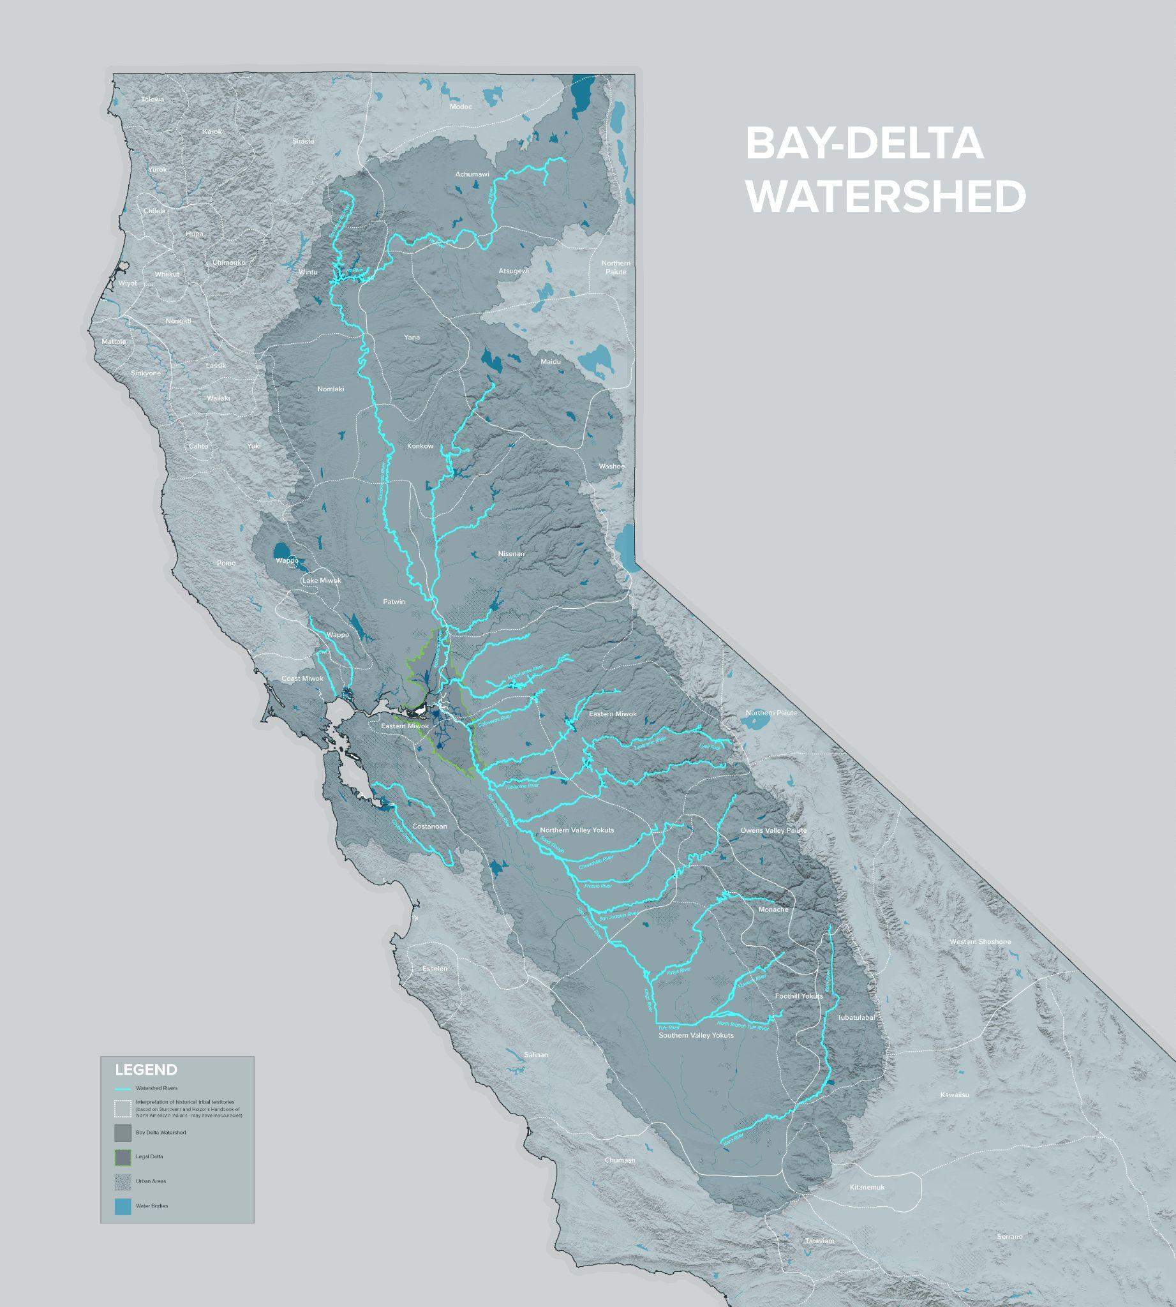
Historic Tribal Territories
Notes:
EJ Tribal paper from Delta Stewardship Council - Tribes think of Delta boundary as an artificial construct, the whole watershed and its larger connection is of great importance. Don't have a subregional watershed; this map is showing what has been articulated as the historical Tribal territories -- multiple Tribes -- legal delta in there for reference, but not approached like this by tribal communities. Tribes relocated so no longer live in what is considered the legal delta.

Slide 51
How the criterion was developed
Extensive public engagement over the course of several years:
Interviews
Indigenous community members & advocates
2 Public Workshops
2024, 2025
3 Tribal Workshops
2024, 2025
Follow-up Expert & Practitioner Consultations
Advisory Committee
Periodic check-in & review
Literature Review

Slide 52
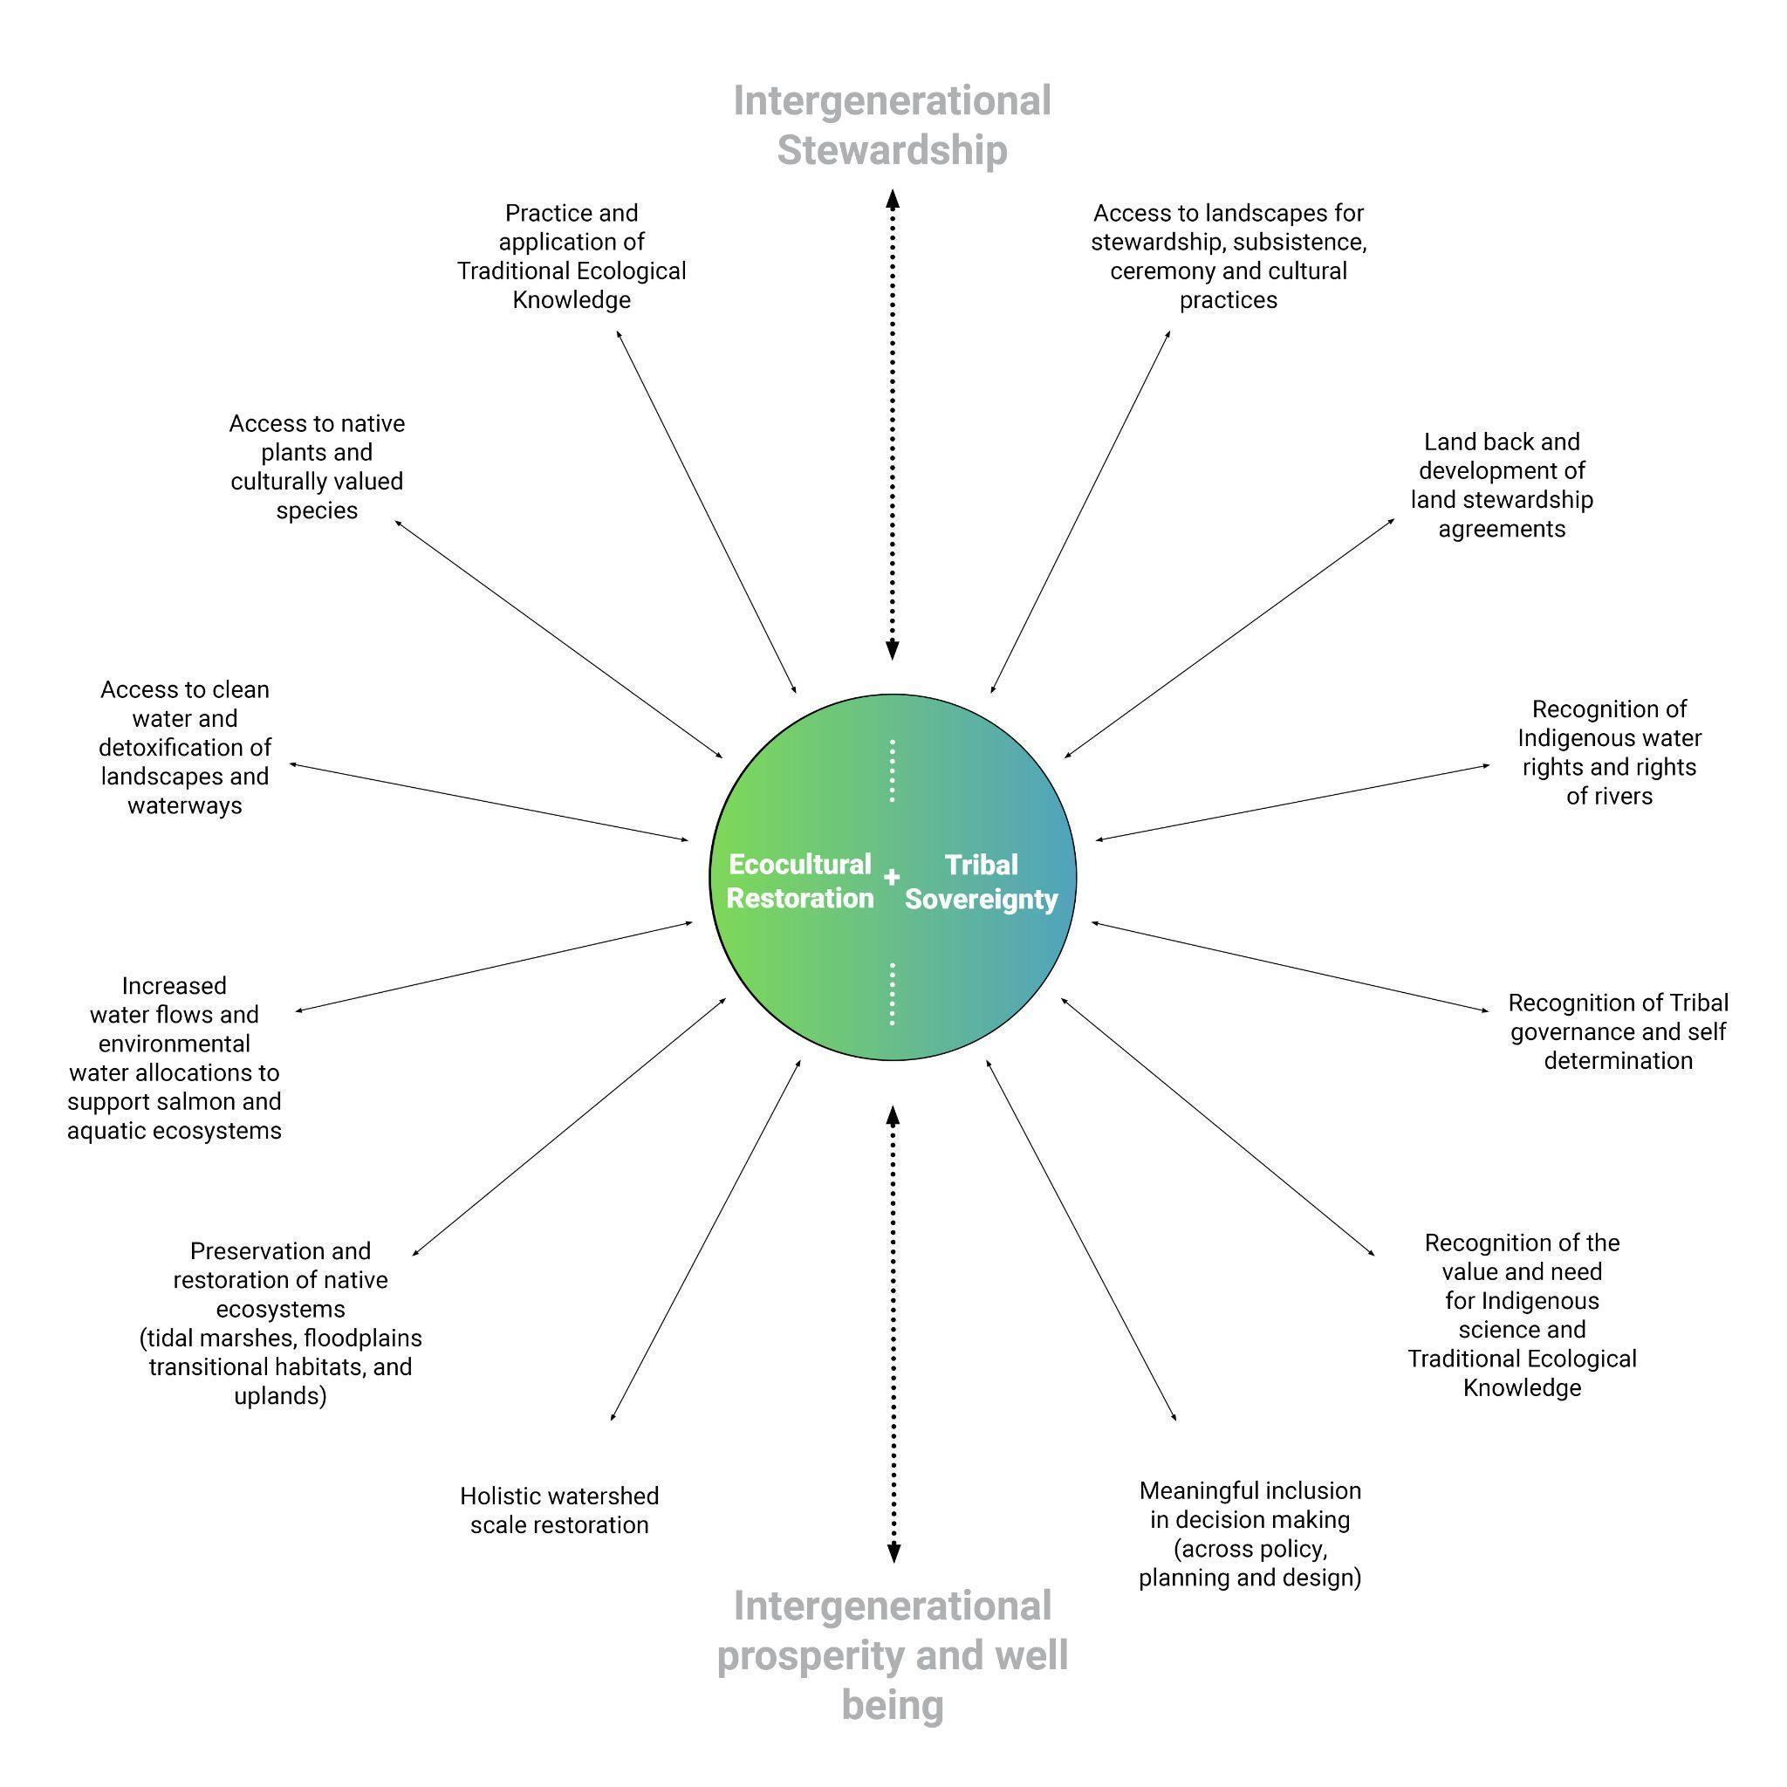
Interconnected & Reciprocal
2 main pillars:
Intergenerational stewardship
Intergenerational prosperity and well-being
Access
Recognition
Inclusion
Preservation and restoration
Practice and application

Slide 53
Ecocultural Restoration & Indigenous Sovereignty Metrics
Metric | Definition | Measurement
Restoration of Native Ecosystems and Ecosystem Functions | Recovering, protecting, and enhancing the web of species and ecosystems that are native to the Delta and culturally significant. | Change in the number of restored acres in each scenario
Increased access to Landscapes for Stewardship, Subsistence, Ceremony, and Cultural Practices | Includes potential efforts to return land to Tribes or co-manage land with Tribes and Tribal governments. | Lists the kind of agreements that can facilitate increased access to land for Tribal communities
Notes:
Many of the metrics cannot be directly measured in the scenarios and are approached as recommendations for how they could potentially be implemented.

Slide 54
Ecocultural Restoration & Indigenous Sovereignty Metrics
Metric | Definition | Measurement
Implementation and Application of Indigenous Science & Traditional Ecological Knowledge (TEK) | Incorporating TEK in the form of best practices into Western management, stewardship, and land-use decisions in partnership and/or consultation with Tribal representatives and TEK practitioners. | Avenues by which TEK applications can be facilitated
Recognition and application of Indigenous sovereignty, Tribal governance, and rights | Advancing the inherent right of Indigenous peoples to govern themselves, their lands, and resources, and to maintain their cultures and Traditional ways of life. | Instances and mechanisms of recognition and application of Indigenous sovereignty, Tribal governance, and rights.

Slide 55
Restoration Results & Scenario Ranking: Adaptation Scenarios
Scenario | -5 | -4 | -3 | -2 | -1 | 0 | +1 | +2 | +3 | +4 | +5
Business As Usual |  |  |  |  |  | ●
Bolster and Fortify |  |  |  |  |  | ●
Eco Machine |  |  |  |  |  |  |  | ●
New Green Watershed |  |  |  |  |  |  |  |  |  |  | ●
Calling on Reserves |  |  |  |  |  | ●
A Tunnel |  |  |  |  |  | ●

Slide 56
Restoration Ranges
ECO MACHINE
In-Delta restoration only
Suisun Marsh
Tidal wetland restoration: 41,720 acres
Franks Tract
Tidal wetland restoration: 1,380 acres
NEW GREEN WATERSHED
In-Delta and upland restoration
In-Delta: 248,815 restored acres
Wetlands, rice, restored landscapes
Watershed (upland):
Managed wetland acreage:
48,213 - 207,004
Meadow acreage: 11,586 - 347,591
Floodplain acreage: 6,360 - 303,372

Slide 57
Increased Access to Landscapes for Stewardship, Subsistence, Ceremony, and Cultural Practices
Most preferred mode of land access: Tribal Ownership
Land Trust Partnership
Agreements between land trusts, conservation organizations, and/or Indigenous communities
Conservation Easements (CE), Cultural Conservation Easements (CCE)
Legally-binding, development restrictions for cultural and ecological protection
Perpetual access, even if land is sold
Memorandum of Understanding (MOU), Memorandum of Agreement (MOA)
Formal agreements between Indigenous Communities and non-Indigenous entities (private landowners, State entities, etc.)

Slide 58
Implementation and Application of Indigenous Science and TEK
Conditions / characteristics necessary:
Ensured Privacy
Safety
Free from outside observation (e.g., photography)
Partnering organizations should not ask why or for what purpose specific stewardship activities are executed
Unrestricted Access
Facilitated by aforementioned agreements and partnerships
Site Selection Choice
Accessible to Elders
Accessible to individuals with restricted mobility

Slide 59
Recognition and Application of Indigenous Sovereignty, Tribal Governance, and Rights
GOVERNANCE
Tribal beneficial/cultural uses of water
Recognition of Tribal water rights
Indigenous representation in planning processes
An inter-Tribal Council for the Delta
Funding for Tribal Stewardship and Indigenous Science Groups
KEY ASPECTS TO ADDRESS
Data Sovereignty
Education (of colonial legacies and current challenges, especially for youth)
Food sovereignty

Slide 60
Overall Results Summary
Integrated, watershed scale restoration, combined with increased flows are the most important/most valued scenario parameters.
Adaptation Scenarios
NEW GREEN WATERSHED
Tiered Outflow Scenarios
30% OUTFLOW INCREASE

Slide 61
Overall Score: Tiered Outflows
Scenario | -5 | -4 | -3 | -2 | -1 | 0 | +1 | +2 | +3 | +4 | +5
Historic Baseline |  |  |  |  |  | ●
30% Flow Increase |  |  |  |  |  |  |  |  | ●
10% Flow Decrease |  |  |  | ●
Flow is extremely important. The health of the Delta directly coincides with the health of Indigenous communities.
Notes:
10% decrease -- You're allowing for more pumping
Already critical so double magnitude

Slide 62
Overall Score: Adaptation Scenarios
Scenario | -5 | -4 | -3 | -2 | -1 | 0 | +1 | +2 | +3 | +4 | +5
Business As Usual |  |  |  |  |  | ●
Bolster and Fortify |  |  |  |  |  | ●
Eco Machine |  |  |  |  |  |  |  | ●
New Green Watershed |  |  |  |  |  |  |  |  |  | ●
Calling on Reserves |  |  |  |  |  |  | ●
A Tunnel |  |  |  | ●
Notes:
COR OVERALL HAS THE POTENTIAL TO CREATE MORE FLOWS FOR FISH - WHEN WATER IS RELEASED TO BENEFIT AQUATIC ECOSYSTEMS - CHANGING OPERATION OF EXISTING INFRASTRUCTURE - WE HAVEN'T BEEN ABLE TO EXPLORE THAT IN OUR MODELING, BUT THIS IS SUPPOSED TO BE ABOUT CHANGE IN OPERATION, GIVEN THAT THEY'RE ALREADY THERE
HIGHLIGHT NGW IS 4 BECAUSE IT'S NOT COMBINED WITH ADDITIONAL FLOW
Think through how to talk about these and give rationale - ask how people would rank it themselves, open conversation

Slide 63
RECREATION
Water-dependent recreational responses to Runoff and Salinity levels in the Delta
Jeff Jenkins & Isaac Sanchez

Slide 64
Criterion Definition
Water-dependent recreation adaptation scenarios measure how salinity and water temperature affect the volume & timing of visitors
Access and recreational species thresholds are measured in proximity to parks and wildlife reserves throughout four Delta regions
Visitor outcomes are assessed during peak seasons:
Winter: waterfowl hunting and bird watching
Summer: angling, boating, and day users
z

Slide 65
Why this criterion matters
The Delta’s recreation and tourism sector has fluctuated over the past two decades, yet remains the second largest sector behind agriculture
  down from a visitor sector high of $312 million in 2012
  produces $250 million in tourism related trips in 2020
Delta water-dependent recreation exists under climate “whiplash”
  2017 a (wet year), preceded by prolonged drought (2012-2016)
  Dry three year period (2020-2022), followed by record wet (2023)
HABs, water quality, and lack of boat-in destinations as well as invasive species are problematic concerns for residents and visitors alike

Slide 66
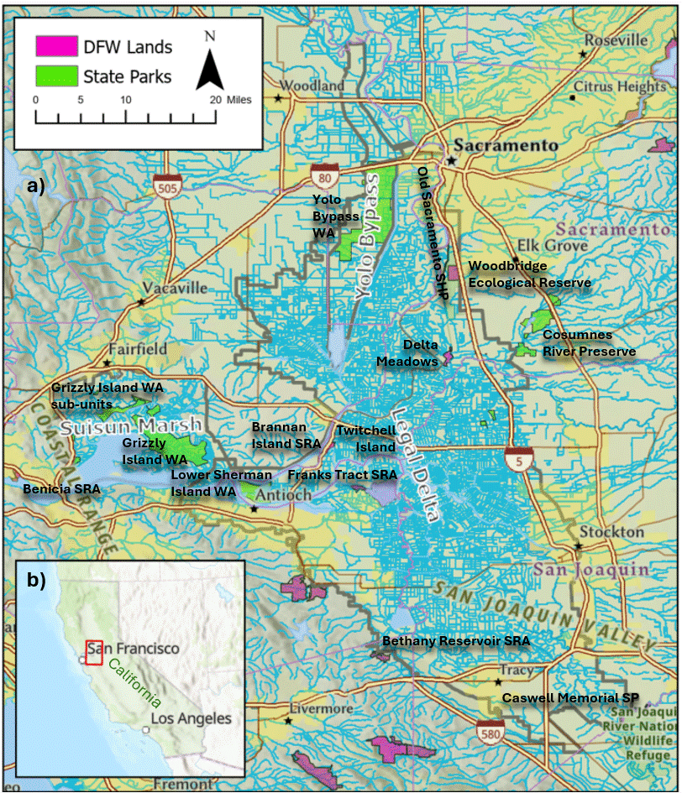
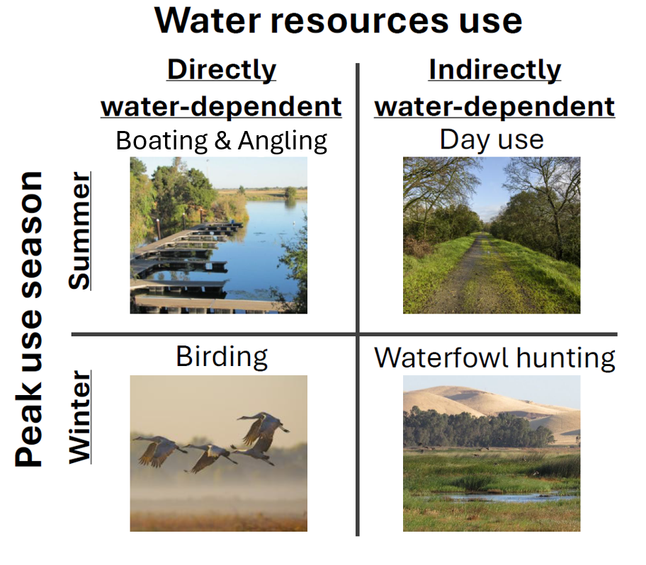
How it was developed
Representative activities for publicly accessible recreation opportunities
Water-dependent recreation

Slide 67
Recreation Metrics
Metric | Definition | Measurement
Overall Use | Baseline directly and indirectly water-dependent recreational opportunities at publicly accessible park and refuge units | Direct: angling participation, boat launches, birding Indirect: waterfowl hunting, day uses
Seasonal Use | Timing and volume of activity relative to yearly salinity and temperature | Quantitative and narrative comparison of activity peaks vs. temperature/salinity peaks, and flows
Restoration | Accessible acreage gained through wetland restoration | Quantitative and narrative estimate of added acreage beyond current inventories
Recreation Economy | Visitor spending and decadal shifts by activity | Narrative grounded in macroeconomic theory and Input-Output visitor spending models

Slide 68
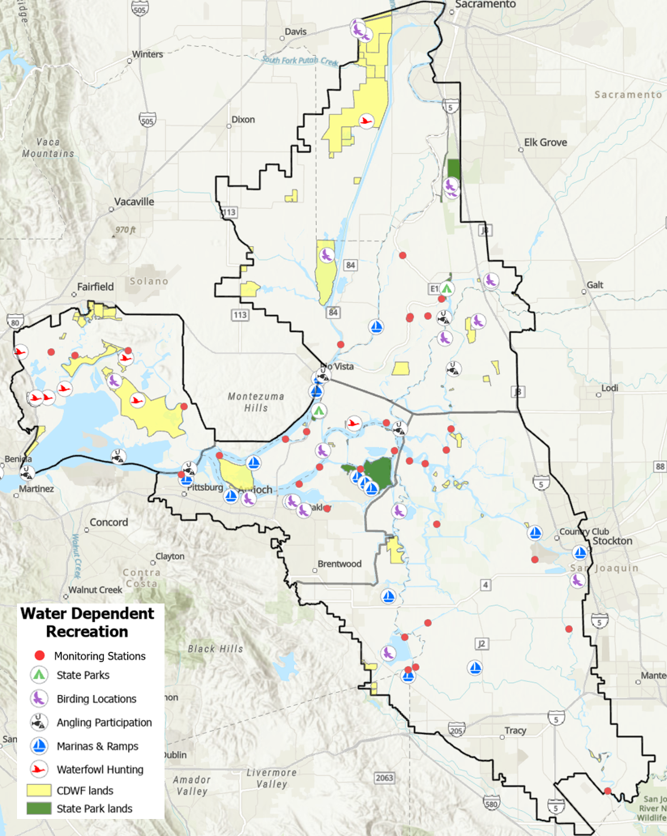
Delta Sub-regions
Delta regions are influenced by tidal geography, salinity and regional hydrological differences Andrews, et al., (2017)
Regional access to recreational opportunities and roadway rationale Delta Plan (2013)
Natural regional aesthetic and winding waterways Olmsted Jr. (1929)

Slide 69
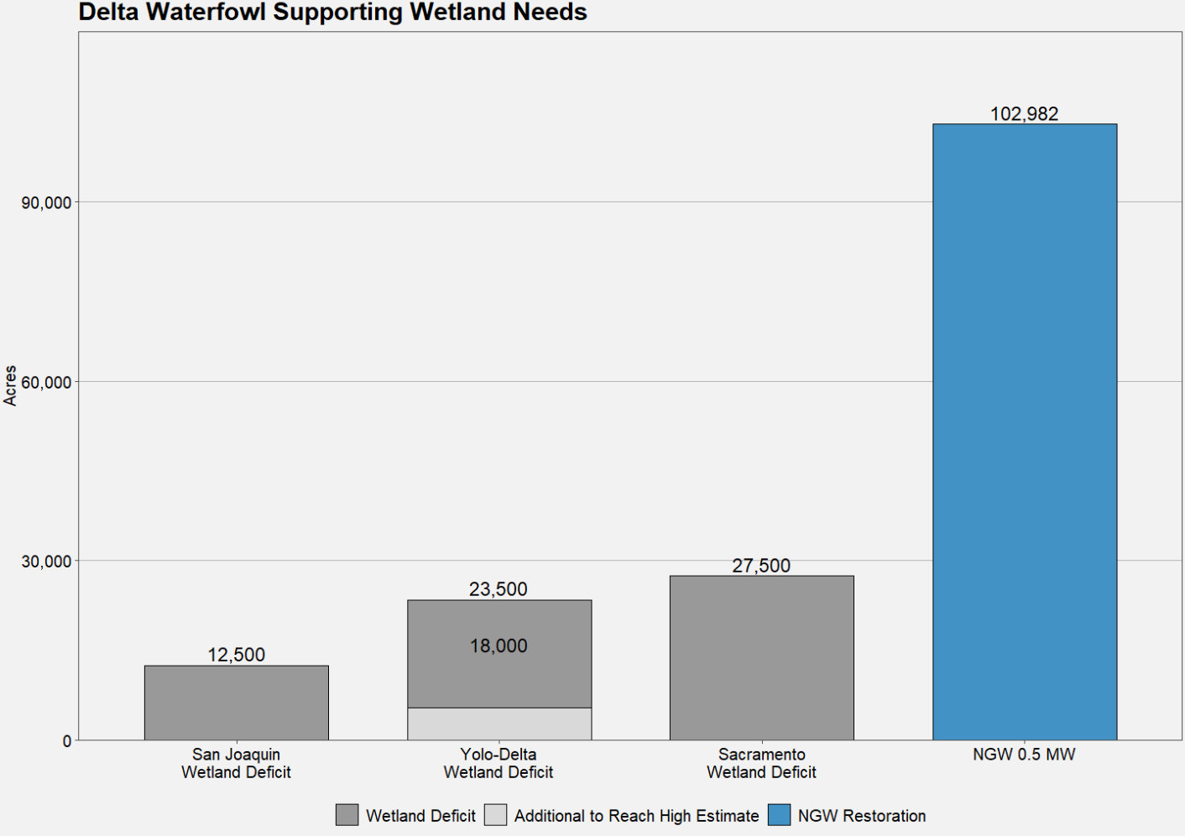
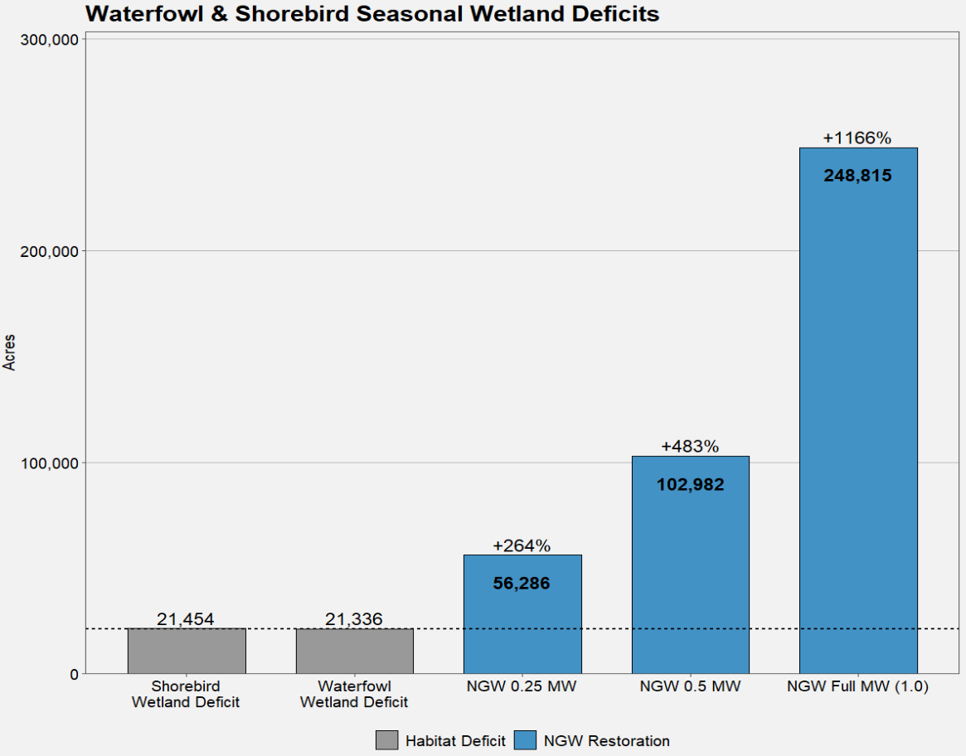
Restoration
Deficits derived from CVJV 2020 Habitat Needs for Delta area Waterfowl and Riparian species

Slide 70
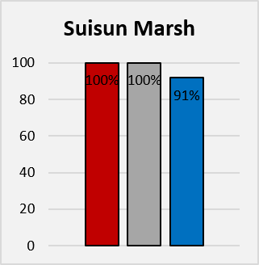
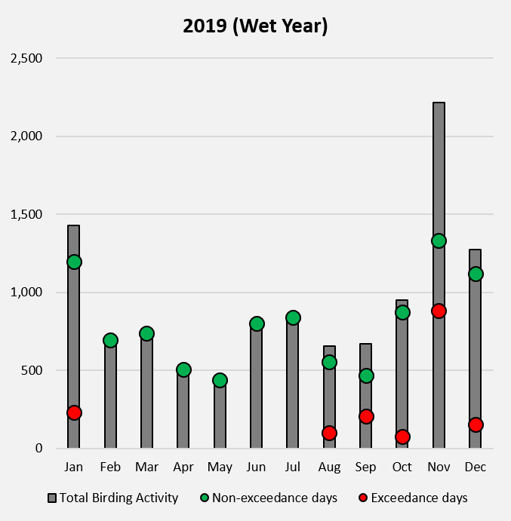
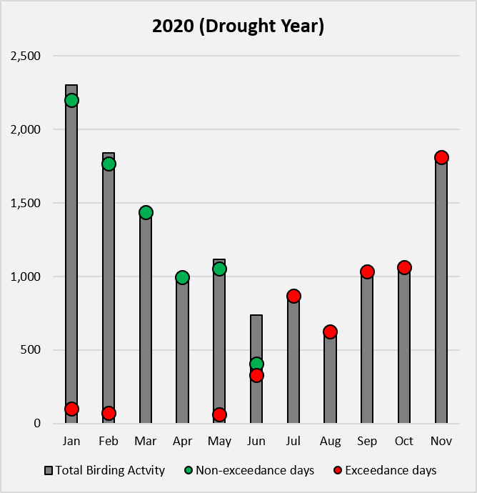
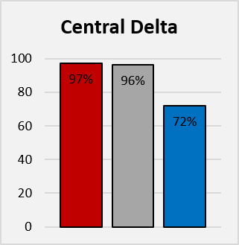
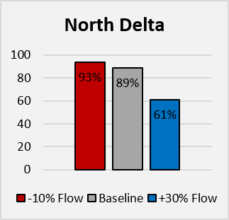
Results
Flow exceedances
2,640 µS/cm
Birdwatcher Sightings
Affected by threshold (2,640 µS/cm)
Performance Ranking
% Mean | Summer | Winter
Business As Usual | 40 | 41
Bolster and Fortify | 40 | 41
Eco Machine | 40 | 44
New Green Watershed | 41 | 44
Calling on Reserves | 48 | 49

Slide 71
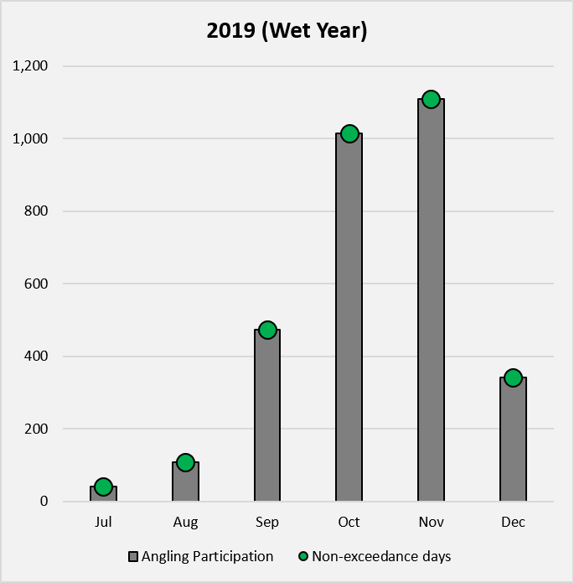
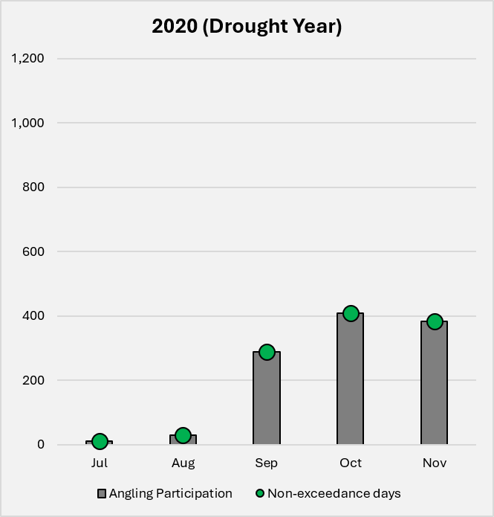
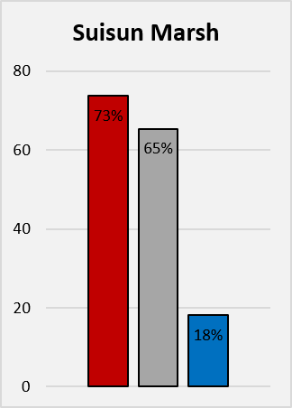
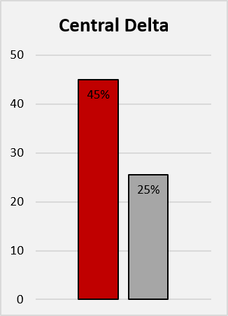
Results
Performance Ranking
Angler participation
affected by threshold (9,130 µS/cm)
Flow exceedances
9,130 µS/cm
% Mean | Summer | Winter
Business As Usual | 5 | 6
Bolster and Fortify | 5 | 6
Eco Machine | 8 | 7
New Green Watershed | 8 | 7
Calling on Reserves | 8 | 10
Notes:
With 50% being midpoint, this scenario really REALLY shines but it really is because adults tolerate salinity rather well

Slide 72
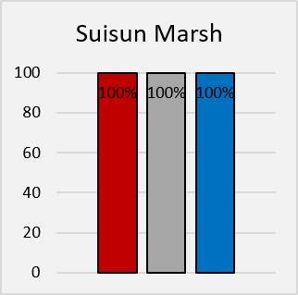
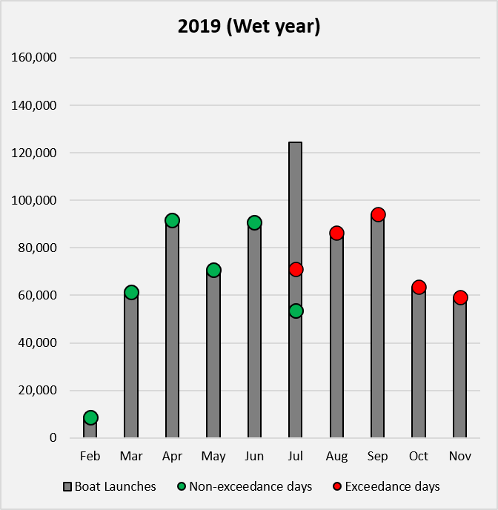
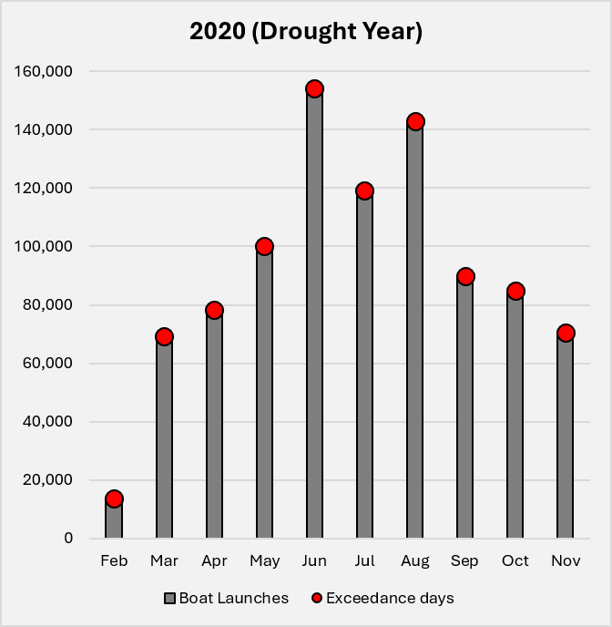
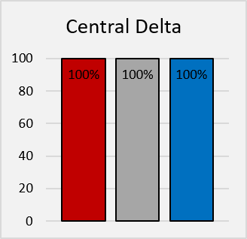
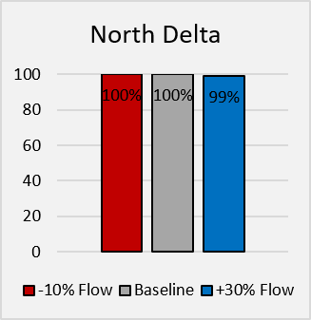
Results
Performance Ranking
Marina boaters
affected by threshold (1,000 µS/cm)
Flow exceedances
1,000 µS/cm
% Mean | Summer | Winter
Business As Usual | 60.5 | 66
Bolster and Fortify | 60.5 | 66
Eco Machine | 61 | 67.5
New Green Watershed | 61 | 67.5
Calling on Reserves | 62 | 65

Slide 73
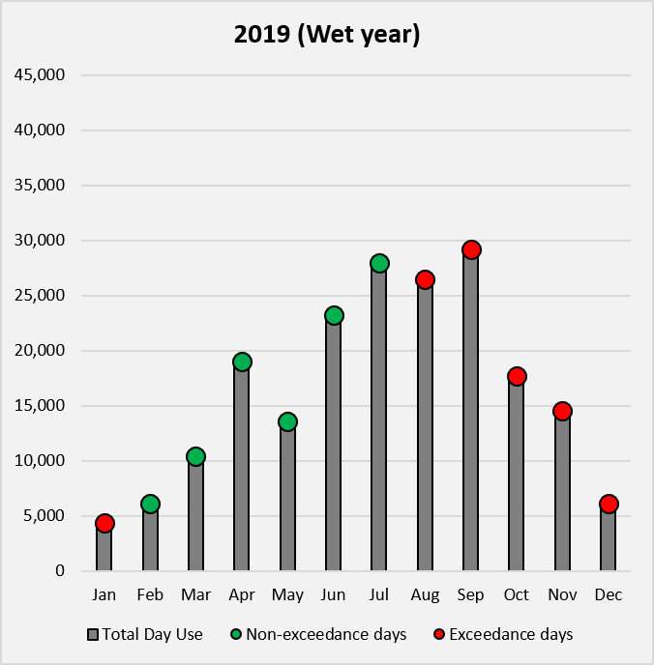
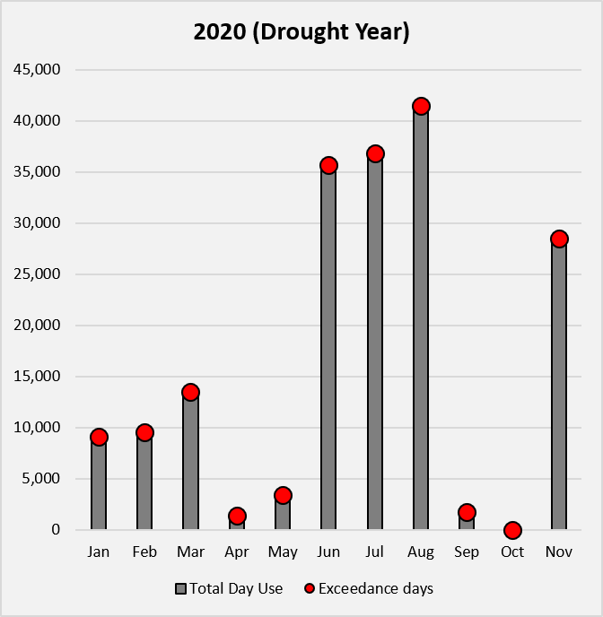
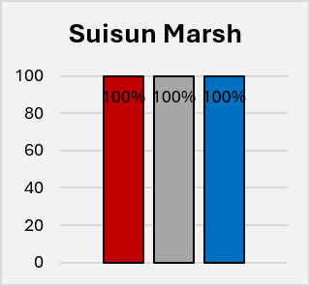
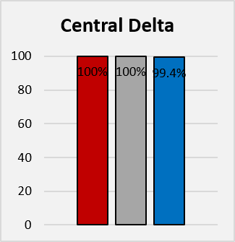
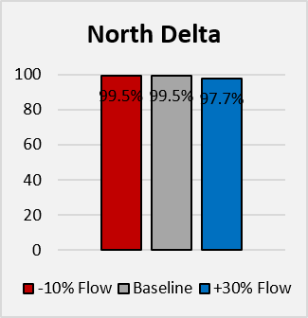
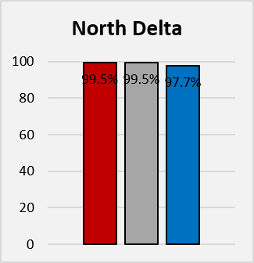
Results
Performance Ranking
Flow exceedances
1,000 µS/cm
State Parks Day Use
affected by threshold (1,000 µS/cm)
% Mean | Summer | Winter
Business As Usual | 60.5 | 66
Bolster and Fortify | 60.5 | 66
Eco Machine | 61 | 67.5
New Green Watershed | 61 | 67.5
Calling on Reserves | 62 | 65

Slide 74
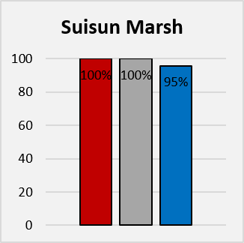
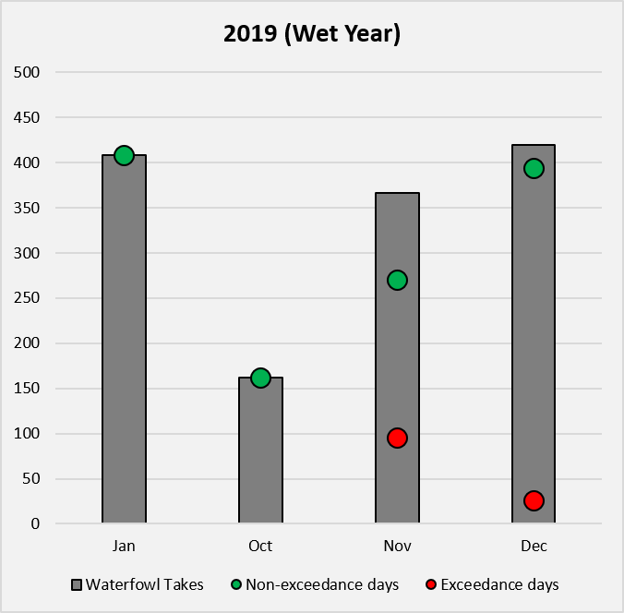
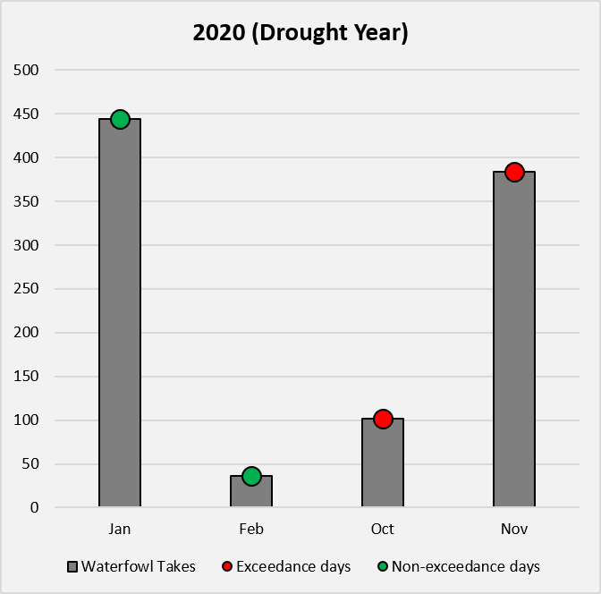
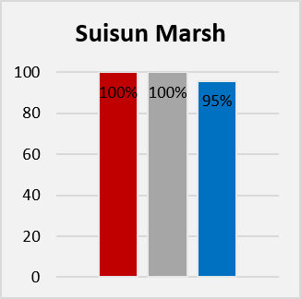
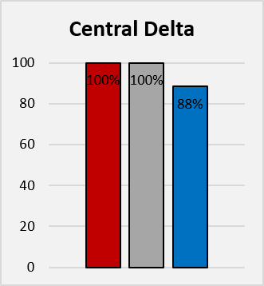
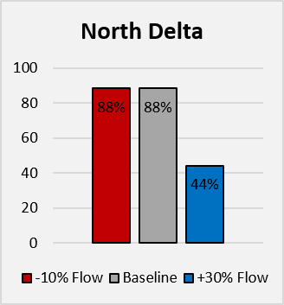
Results
Performance
Flow exceedances
1,000 µS/cm
Waterfowl hunting
affected by threshold (3,600 µS/cm)
% Mean | Summer | Winter
Business As Usual | 32 | 34
Bolster and Fortify | 32 | 34
Eco Machine | 32.7 | 38
New Green Watershed | 32.6 | 37
Calling on Reserves | 38 | 43

Slide 75
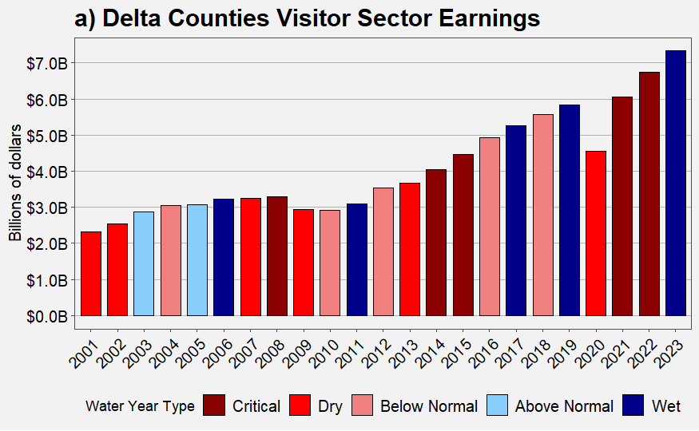

Results Visitor-sector Earnings by Water Year
Earnings by place of work (BEA Regional Economic Accounts): Arts, entertainment and recreation, & Accommodation and food services

Slide 76
Scenario Ranking: Salinity + Temperature (% of -5 to 5)
Scenario | Bird Watching | Angling | SP Day Use | Boating | Waterfowl Hunting
Business As Usual | 38 | 5.5 | 57 | 53.1 | 21
Bolster and Fortify | 38 | 5.5 | 57 | 53.1 | 21
Eco Machine | 39 | 7.5 | 58.2 | 53.6 | 22.3
New Green Watershed | 39.2 | 7.5 | 58.2 | 53.7 | 22.2
Calling on Reserves | 44 | 9 | 58 | 53.1 | 25
A Tunnel (Pending)
New Green Watershed (0.25) MW
New Green Watershed (0.5) MW
New Green Watershed Full (1.0) MW

Slide 77
Overall Results Summary
Adaptation management benefits are activity-specific
  angling performs the best of the five activities occurring below species affecting scenario thresholds for recreation important fisheries: 9,130 µS/cm habitat threshold that fails to reach outside Suisun under greater flow regimes
  wetland rehabilitation for summer breeding and migratory winter waterfowl would require a combined acreage of water flow of about ~1,065,778 acre-feet/yr for an extra 63,500 wetland restored acres to support waterfowl and bird species, falling right below 0.5% MW scenario
Multi-decadal visitor sector wages are positively retained under wet and critical water year conditions compared to near average years
Winter birding and waterfowl activities dependent on late fall runoff conditions, and summer activities driven by pull of water resources indicated by late spring runoff conditionsUnder +30% flows, species and activities in the North and Central Delta cross fewer threshold days than under either the baseline or -10% flow scenarios at the regional scale

Slide 78
ECONOMY
Assessing Impacts of Future Delta Salinity Management Scenarios on Delta Agricultural Production
Yu Cai & Josué Medellín-Azuara
Notes:
About 15 minutes. Economy criterion: what salinity management and land conversion do to Delta farm revenue, jobs and value added. A Tunnel results are pending and are not shown.

Slide 79
Criterion Definition
When the Delta's water gets saltier, or when farmland is converted to something else, what happens to the Delta's economy?
We track three measures, each relative to Business As Usual:
Gross Revenue
Dollar sales from Delta farms
Employment
Full- and part-time jobs on farms and in the businesses tied to them
Value Added
Wages, business income and taxes; close to regional GDP
Notes:
Three measures, all annual changes relative to Business As Usual. Direct effects are on-farm; total effects add IMPLAN's regional multiplier (indirect and induced).

Slide 80
Why This Criterion Matters
The Delta supports a working farm economy, plus the packing houses, equipment dealers, trucking and recreation that depend on it. Every one of the six futures affects that economy: some through salt water reaching farm fields, others by converting farmland to wetland. Measuring the size of those effects, and where they fall, is a direct way to compare the futures.
$1.1B/yr
direct farm sales
(DAP basecase)
7,650
direct farm jobs
(11,814 including multiplier)
$671M/yr
direct value added
($999M including multiplier)
Notes:
Baseline figures from the DAP basecase and Yu Cai's IMPLAN run: $1,107M direct gross revenue, 7,650 direct jobs (11,814 total), $671M direct value added ($999M total).

Slide 81

How It Was Developed
Salinity pathway (six futures; A Tunnel pending)
Hydrodynamic salinity (RMA) → crop yield loss → OpenAg → IMPLAN
Wet year 2019 and dry year 2020
Land-use pathway: New Green Watershed
DAP crop acreage and revenue, island by island, for three restoration levels (0.25MW, 0.5MW, Full MW) → adjusted baseline → IMPLAN (Cai et al., in prep.)
Land-use pathway: Eco Machine
Suisun Marsh: CDFW 2021 vegetation survey, DWR 2024 crop mapping and OpenAg revenue per acre
Franks Tract: Franks Tract Futures 2020 design
Farm losses scaled with the same IMPLAN ratios; carbon and construction from Deverel et al. (in press)
Notes:
Two modeling chains. The salinity chain runs every scenario through RMA salinity, crop yield loss, OpenAg and IMPLAN. The land-use chain removes converted farmland from the economic baseline: for New Green Watershed with the DAP model and IMPLAN; for Eco Machine with a spreadsheet calculator using the same IMPLAN ratios, because very little of its land is farmed.

Slide 82
Economy Metrics
Metric | Definition | Measurement
Gross Revenues | Estimated change in gross value of sales by a sector, e.g. agriculture, the gate value of crops | US Dollars annualized (2024)
Jobs | The estimated change in employment over the course of a year by sector | Full and part time jobs for a sector in a year.
Value Added | A measure close to Gross Domestic Product given by the difference between Gross Revenues and non-labor business expenses, change. | US Dollars annualized (2024)
Notes:
Measured in annual dollars and jobs. Carbon and construction figures from Deverel et al. are in 2022 dollars; the difference from 2024 dollars is small next to the uncertainty.

Slide 83

Delta Sub-regional Zones
Four zones: North, Central and South Delta (water agency boundaries) and West Delta. Suisun Marsh lies outside these zones and enters through the Eco Machine land-use estimate.
Change in value added ($) by zone, dry year 2020, salinity pathway. Each panel uses its own color scale.
Notes:
Example of the zone results: dry-year change in value added, salinity pathway only. Changes are a few thousand dollars per zone.

Slide 84
Overall Results
Salinity barely moves the farm economy. In every scenario modeled so far (A Tunnel pending), gross revenue changes by less than 0.01% in both the wet and the dry year.
New Green Watershed is the large effect. Converting farmland lowers direct farm revenue by $212.7M–$505.6M/yr (19–46%) and total regional revenue by $329.0M–$749.0M/yr.
Eco Machine takes little farmland. It converts 14,000–54,000 acres to tidal marsh but loses at most $1.2M/yr of farm revenue; its main cost is construction, about $0.85–1.5 billion.
Carbon credits offset only a small part. At $15/tCO2e they cover about 8–11% of New Green Watershed's revenue loss (including Eco Machine), and probably less (see cautions).
Notes:
Four messages. Salinity effects are tiny. New Green Watershed is a large, real tradeoff. Eco Machine is a construction question, not a farm question. Carbon is a partial, uncertain offset.

Slide 85

Salinity Pathway: Gross Revenue
Base: $1.107 billion/yr
Largest dry-year loss: Bolster and Fortify, –$34,000 (–0.003%), mostly Central Delta
Calling on Reserves: about –$1,000 (dry) and +$4,000 (wet)
Wet year: New Green Watershed salinity run +$468,000 (+0.04%)
Notes:
OpenAg gross revenue by scenario. Bars on the left use a truncated axis; the changes on the right are in thousands of dollars on a base of $1.1 billion. A Tunnel results are pending.

Slide 86

Salinity Pathway: Jobs and Value Added
All changes below 0.01% of the Delta baseline (11,860 jobs; $1.0 billion value added)
Largest job change: +0.13 jobs (Eco Machine, dry year)
Largest value-added loss: –$9,500 (Bolster and Fortify, dry year)
Notes:
IMPLAN totals from the salinity pathway. These effects are negligible in absolute terms; the pattern matches gross revenue.

Slide 87
New Green Watershed: Land Conversion
Restoration level | Managed wetland (ac) | Rice (ac) | Direct revenue change | Total revenue change (IMPLAN) | Total jobs change
Full MW | 207,004 | 0 | –$504.5M (-45.6%) | –$747.3M (-45.8%) | -5,125 (-43.4%)
0.5MW | 85,523 | 121,500 | –$282.5M (-25.5%) | –$429.2M (-26.3%) | -4,121 (-34.9%)
0.25MW | 48,213 | 156,700 | –$212.4M (-19.2%) | –$328.6M (-20.1%) | -3,783 (-32.0%)
Where: at Full MW, total revenue falls most in the West (–65%) and Central Delta (–64%), less in the North (–42%) and South (–33%).
Rice islands keep some revenue: rice earns about $1,827/ac gross, so 0.25MW and 0.5MW lose less than Full MW.
Including Eco Machine adds only $0.3M–$1.2M/yr to the direct loss; the percentages do not change.
Notes:
DAP basecase and Yu Cai's IMPLAN run. Direct baseline $1,107M; total baseline $1,632M; total jobs baseline 11,814. Percentages are relative to those baselines. Regional shares are Full MW total revenue.

Slide 88

Carbon Offsets at $15/tCO2e
Headline: $21.5M–$34.2M/yr, about 7–10% of the loss (Delta-wide part; Eco Machine adds $1.6M–$5.9M/yr).
Cautions
Rates come from four deeply subsided islands owned by MWD (Deverel et al., in press)
65% of Full MW wetland acres are on minimally subsided, likely mineral soils: carbon could be 57–65% lower
Corn assumed as the baseline crop on every acre; 10% uncertainty deduction and verification costs not subtracted
$30/tCO2e (not in writing) would double the headline
Notes:
Carbon at the Deverel et al. conservative price of $15/tCO2e with a 14% risk deduction: $165 per acre of wetland, $86 per acre of rice. The amber bars count credits only on moderately and severely subsided islands, since converting corn on mineral soil raises emissions (Deverel et al. Table A2). Treat carbon as an upper-end possibility.

Slide 89
Eco Machine: Suisun + Franks Tract
Suisun land restored | Acres to tidal marsh* | Farm revenue lost | Carbon ($15/t) | Construction (one-time)
25% | 14,431 | –$0.29M/yr | $1.6M/yr | $855M
50% | 27,492 | –$0.58M/yr | $3.0M/yr | $1,076M
100% | 53,614 | –$1.15M/yr | $5.9M/yr | $1,519M
Franks Tract benefits (not in the dollar totals)
Lower salinity and fewer fish drawn to the export pumps
Fewer emergency drought barriers (2015 barrier: about $37M)
More effective use of the $4–8M/yr now spent on weed control
Wave protection for Bethel Island levees
Better boating and bass fishing; about half of Bethel Island jobs depend on recreation
Costs noted: construction disruption; 29–36 fewer water-based duck blinds.
*Includes 1,370 acres at Franks Tract.
Suisun: 52,244 leveed acres, mostly managed wetlands used as duck clubs; about 2,000 acres farmed. The scenario does not yet fix how much is restored.
Franks Tract Futures 2020 design: 1,370 acres of marsh and land from 37 million cubic yards dredged on site; $560M (2020) ≈ $633M (2022), 4–9 years to build.
Carbon at $15/t would take more than 200 years to repay construction.
Notes:
Eco Machine's farm effect is very small, so its score is 0. Its economic questions are construction cost and, in Suisun, the duck-club economy, which this criterion does not measure. Franks Tract's benefits come from the Franks Tract Futures 2020 report and belong mainly to the water supply, water quality and recreation criteria.

Slide 90
Scenario Ranking: Economy
Scenario | -5 | -4 | -3 | -2 | -1 | 0 | +1 | +2 | +3 | +4 | +5
Business As Usual |  |  |  |  |  | ●
Calling on Reserves |  |  |  |  |  | ● dry | ● wet
Bolster and Fortify |  |  |  |  | ●
Eco Machine |  |  |  |  |  | ●
A Tunnel (pending)
New Green Watershed 0.25MW |  |  | ●
New Green Watershed 0.5MW |  | ●
New Green Watershed Full MW | ●
Same score for gross revenue, jobs and value added. 0 = Business As Usual. A Tunnel: results pending.
Notes:
Salinity-only scenarios score near zero; Bolster and Fortify is slightly negative in the dry year; Calling on Reserves is 0 in the dry year and +1 in the wet year. Eco Machine scores 0 because its farm losses are at most about 0.1% of the baseline. New Green Watershed scores -3 to -5 depending on restoration level.

Slide 91
Takeaways and Next Steps
Takeaways
Salinity management alone has a negligible effect on the Delta farm economy
New Green Watershed is a real economic tradeoff: 19–46% of direct farm revenue, and 32–43% of total farm-related jobs. This would require economic transitions, such as likely increases in the recreational sector and potential conservation incentivizing mechanism (i.e. CA 30 x 30 initiative). In the long term, this scenario may keep more land viable for agricultural production due to subsidence reversal and flood risk reduction.
Eco Machine's costs are construction and the Suisun duck-club economy, not farming
Carbon credits help at the margin; they are not a replacement for farm income
Next steps
•Refine Suisun footprint in the RMA Eco Machine run
•Island-level carbon estimates
•Potentially, added economic value of Suisun duck clubs, waterfowl hunting and other types of recreation and recreation services
•Long term retention (rather than loss) and flood risk reduction of agricultural land through subsidence reversal techniques (New Green Watershed scenario)
•Additional model runs on tunnel scenario plus other land conversion impacts in Eco-Machine and New Green Watershed
Notes:
Close with the tradeoff: restoration benefits (habitat, carbon, flood protection, water quality) are assessed in other criteria; this criterion shows the farm-economy cost those benefits must be weighed against.

Slide 92

LIVE POLL
Notes:
Close with the tradeoff: restoration benefits (habitat, carbon, flood protection, water quality) are assessed in other criteria; this criterion shows the farm-economy cost those benefits must be weighed against.

Slide 93

SCENARIO RANKING
Notes:
Close with the tradeoff: restoration benefits (habitat, carbon, flood protection, water quality) are assessed in other criteria; this criterion shows the farm-economy cost those benefits must be weighed against.

